Slide 1
A publicly-verifiable mix-net with everlasting privacy towards observers
Denise Demirel

Slide 2
Authors
Denise Demirel, Department of Computer Science, Cryptography and Computer Algebra Group, Technische Universität Darmstadt,
Germany
Jeroen van de Graaf, Departamento de Ciência de Computação, Universidade Federal de Minas Gerias,
Brazil

Slide 3
Motivation (1)
Mix-nets were introduced by Chaum in 1981.
Re-encryption mix-nets [1993, Park et al.] use the homomorphic property of some public-key cryptosystems.
This type of mix-net is used in many eVoting systems e.g. Prêt à Voter, Helios and Civitas.
Process set of input values in a way that link between single input and associated output is removed while content remains unchanged.
Notes:
Re-encryption mix-nets were proposed in by Park et al. In 1993

Slide 4
Motivation (2)
Votes are encrypted using public key cryptography. Voter gets a receipt.
Voter verifies that the encrypted vote is contained in the tally and that the ciphertext is unmodified.
Mix-nets are used to make these votes anonymous before decrypting.
Verification of its correct function by publishing additional information.
Notes:
Re-encryption mix-nets were proposed in by Park et al. In 1993

Slide 5




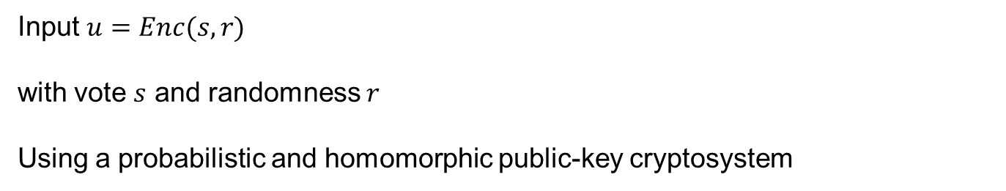

Anonymisation – Mix-nets
Input $u=Enc(s,r)$
with vote $s$ and randomness $r$
Using a probabilistic and homomorphic public-key cryptosystem
A
B
C
$$\left\langle u\right\rangle$$
$$\left\langle u_{A}\right\rangle$$
$$\left\langle u_{B}\right\rangle$$
$$\left\langle u_{C}\right\rangle$$
$$\left\langle t\right\rangle$$
Public Bulletin Board

Slide 6
Computational Privacy
Homomorphic Public-Key Cryptography e.g. Paillier, Elgamal
Computational assumptions
Brute-Force
Key length currently use will remain secure for less than 30 years (Shamir 2006)
Principle of free suffrage

Slide 7
Related Work – everlasting privacy in poll-site voting
Moran and Naor: Split-Ballot Voting 2010
Votes are cast on paper ballots (secret sharing)
Provides everlasting privacy (Pedersen commitments)
Using a “mix-net”-like shuffle
Trust is distributed between two authorities
Back-end enforces the used of the Split-Ballot Front-end
Reduces the level of computational privacy
Notes:
Finding a general approach which can be used independently of the Front-end also by other electronic voting systems
Compared to current mix-nets where I have more than two mixes. Approach which is scaleable

Slide 8
Mix-net Providing Everlasting Privacy towards observer
Goal: Having all published data (Bulletin Board, receipts) even a computationally unbounded attacker cannot reveal the cast voting decision.
Solution: Encryption of the cast voting decision using a “One-Time-Pad”.
Challenge: How can I make the pair of voting decision and associated key anonymous providing verifiability and everlasting privacy regarding the published information?
Notes:
modular addition

Slide 9



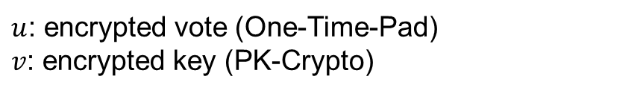






Anonymisation
$u$: encrypted vote (One-Time-Pad)
$v$: encrypted key (PK-Crypto)
Private
$$\left\langle v\right\rangle$$
$$\left\langle v_{A}\right\rangle$$
$$\left\langle v_{B}\right\rangle$$
$$\left\langle v_{C}\right\rangle$$
A
B
C
$$\left\langle u\right\rangle$$
$$\left\langle u_{A}\right\rangle$$
$$\left\langle u_{B}\right\rangle$$
$$\left\langle u_{C}\right\rangle$$
$$\left\langle t\right\rangle$$
Public Bulletin Board

Slide 10
Anonymisation
$u$: encrypted vote (One-Time-Pad)
$v$: encrypted key (PK-Crypto)
Private
$$\left\langle v\right\rangle$$
$$\left\langle v_{A}\right\rangle$$
$$\left\langle v_{B}\right\rangle$$
Public verification
process
$$\left\langle v_{C}\right\rangle$$
A
B
C
Private verification process
$$\left\langle u\right\rangle$$
$$\left\langle u_{A}\right\rangle$$
$$\left\langle u_{B}\right\rangle$$
$$\left\langle u_{C}\right\rangle$$
$$\left\langle t\right\rangle$$
Public Bulletin Board

Slide 11
Assumptions Mix-net (1)
Correctness:
The published data is verified.
There exists a write only public bulletin board.
The authorities cannot break the discrete log problem.
The random challenge is not predictable and comes from a trusted beacon.

Slide 12
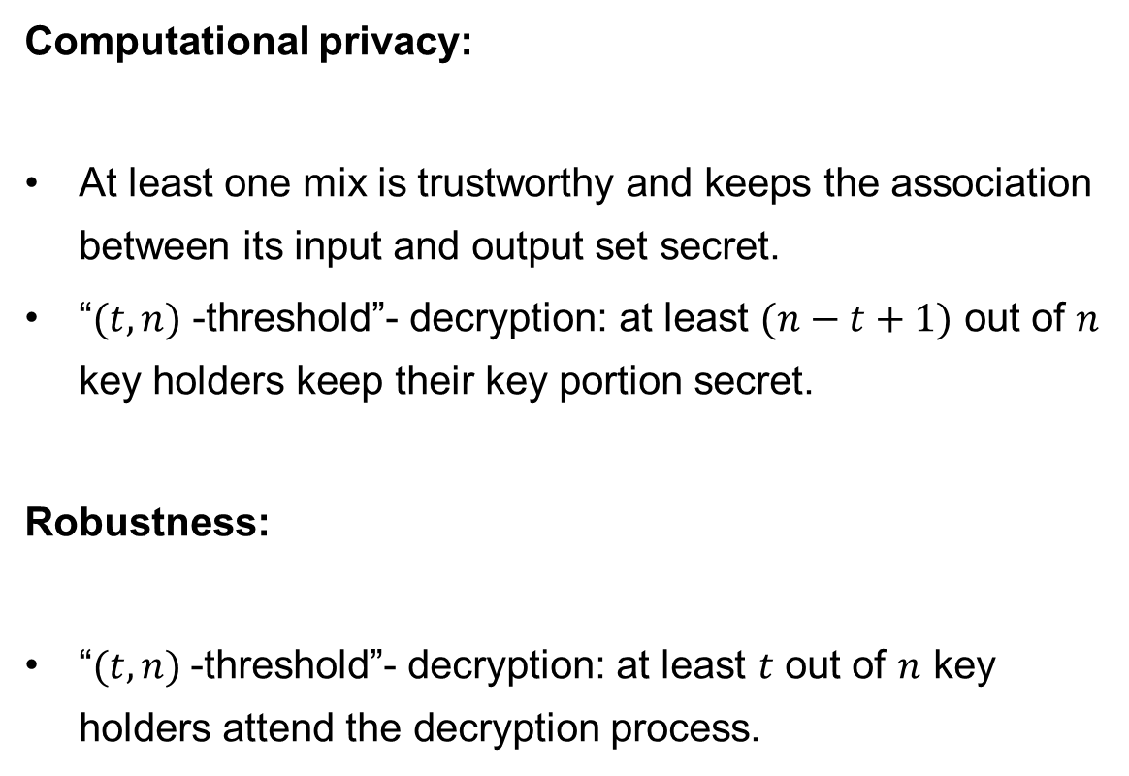
Assumptions Mix-net (2)
Computational privacy:
At least one mix is trustworthy and keeps the association between its input and output set secret.
“$(t,n)$ -threshold”- decryption: at least $(n−t+1)$ out of $n$ key holders keep their key portion secret.
Robustness:
“$(t,n)$-threshold”- decryption: at least $t$ out of $n$ key holders attend the decryption process.
Notes:
Keine Kooperation zwischen A1, A2 und Z (bricht Langzeitsicherheit)

Slide 13
Additional Assumptions Mix-net
Everlasting privacy towards observers:
The mixes can communicate via a private channel.
Robustness:
The private output of each mix is verified.

Slide 14
Properties (1)
Individual Verifiability: Each voter can convince himself that his vote is included in the input batch.
Universal Verifiability: Any observer can verify that the shuffling process was performed correctly.
Correctness: Changes on the content of the encrypted data will be detected with overwhelming probability even if all authorities collaborate.

Slide 15
Properties (2)
Computational Privacy: During the election, the voting decision remains secret as long as a minimum number of authorities act honest.
Everlasting Privacy towards observers: All published data do not reveal any (Shannen) information about the encrypted voting decision.
Robustness: The protocol always terminates successfully if the authorities follow it correctly. If one authority cheats, it will get caught with overwhelming probability.

Slide 16
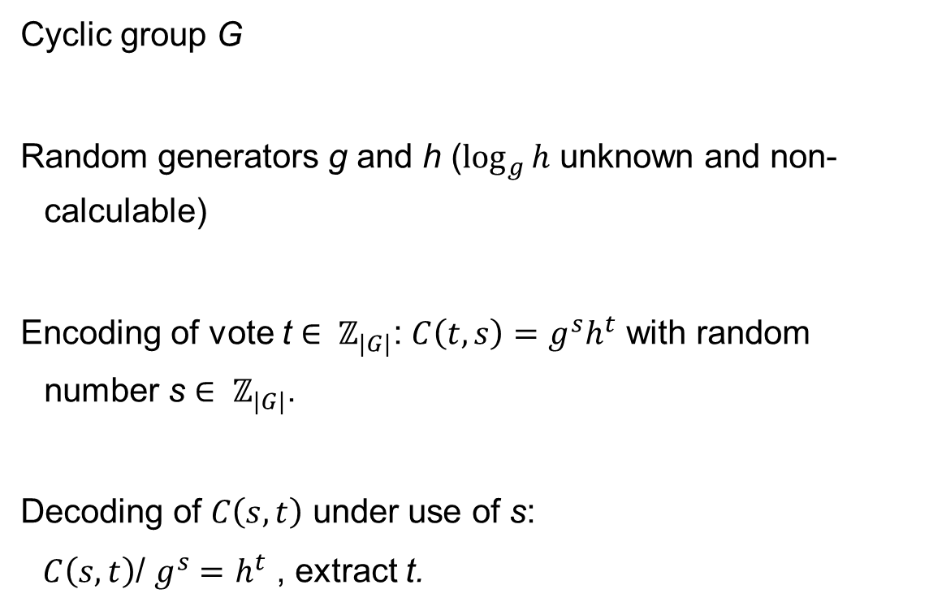
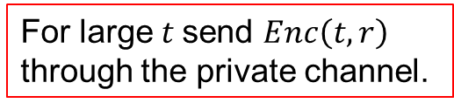
“Encoding” using Pedersen Commitments
Cyclic group G
Random generators g and h ($\log_{g}{h}$ unknown and non-calculable)
Encoding of vote t $∈ ℤ_{|G|}$: ${C\left(t,s\right)=g}^{s}h^{t}$ with random number s $∈ ℤ_{|G|}$.
Decoding of $C\left(s,t\right)$ under use of s:
$C\left(s,t\right)$/ $g^{s}=$ $h^{t}$ , extract t.
For large $t$send $Enc\left(t,r\right)$ through the private channel.
Notes:
Pedersen 1991,
Multi-Authority Secret-Ballot Elections with Linear Work Ronald Cramer, Matthew Franklin, Berry Schoenmakers, Moti Yung 1996
Seit 2006 Split Ballot von Tal Moran und Moni Naor

Slide 17
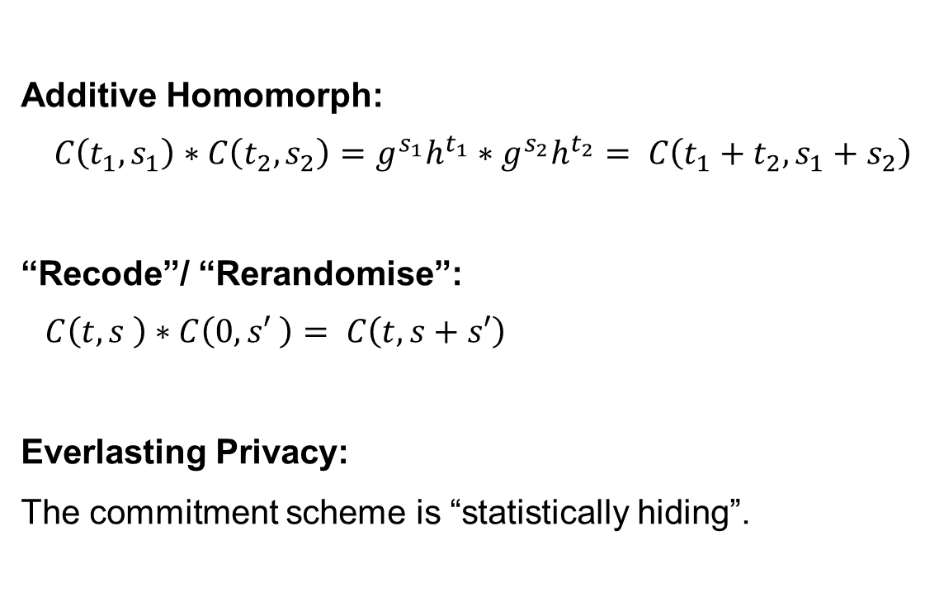
Properties of Pedersen Commitments
Additive Homomorph:
$${C\left(t_{1},s_{1}\right)∗{C\left(t_{2},s_{2}\right)=g}^{s_{1}}h^{t_{1}}∗g}^{s_{2}}h^{t_{2}}= C\left(t_{1}+t_{2},s_{1}+s_{2}\right)$$
“Recode”/ “Rerandomise”:
$$C\left(t,s \right)∗C\left(0,s′ \right)= C\left(t,s+s′\right)$$
Everlasting Privacy:
The commitment scheme is “statistically hiding”.

Slide 18
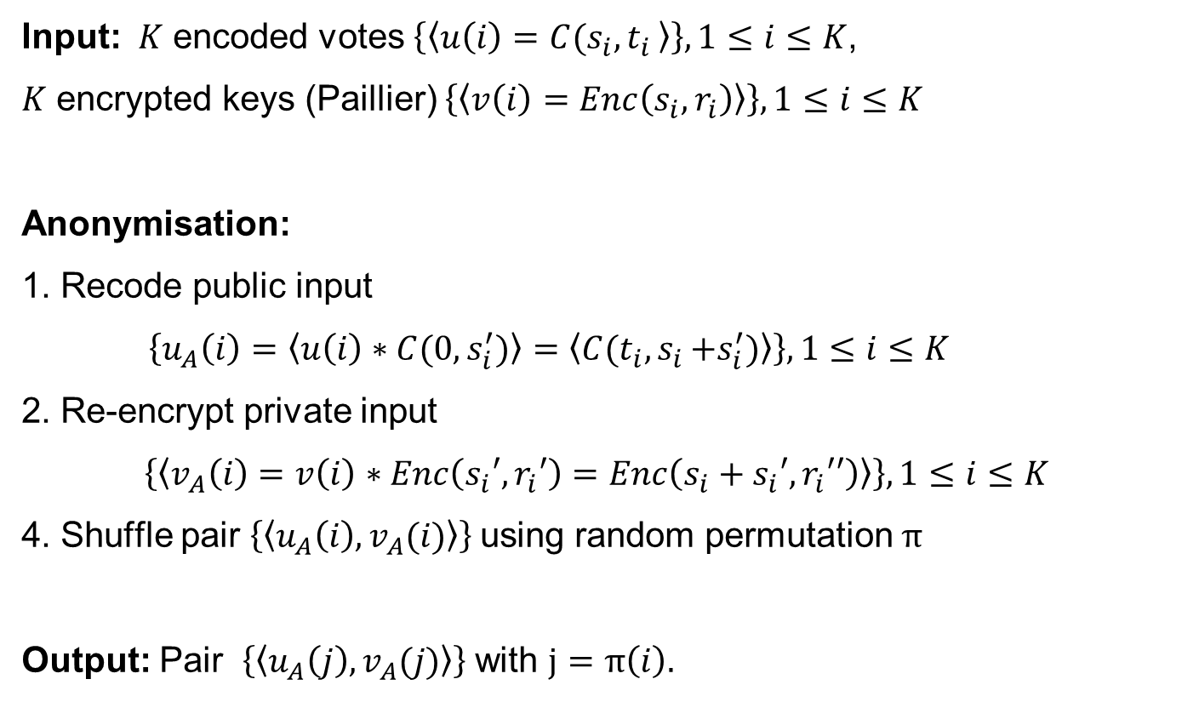
Anonymisation
Input: $K$ encoded votes $\left\{\left\langle u\left(i\right)=C(s_{i}{,t}_{i}\right\rangle \right\}, 1≤i≤K$,
$K$ encrypted keys (Paillier) $\left\{\left\langle v\left(i\right)=Enc\left(s_{i},r_{i}\right)\right\rangle \right\}, 1≤i≤K$
Anonymisation:
1. Recode public input
$\left\{u_{A}\left(i\right)=\left\langle u\left(i\right)∗C(0,s_{i}^{′})\right\rangle =\left\langle C(t_{i}{,s}_{i}+s_{i}^{′})\right\rangle \right\}, 1≤i≤K$
2. Re-encrypt private input
$\left\{\left\langle v_{A}\left(i\right)=v\left(i\right)∗Enc\left(s_{i}′,r_{i}′\right)=Enc\left(s_{i}+s_{i}′,r_{i}′′\right)\right\rangle \right\}, 1≤i≤K$
4. Shuffle pair $\left\{\left\langle u_{A}\left(i\right), v_{A}(i)\right\rangle \right\}$using random permutation $π_{ }$
Output: Pair $\left\{\left\langle u_{A}\left(j\right), v_{A}(j)\right\rangle \right\}$with $j=π\left(i\right).$

Slide 19
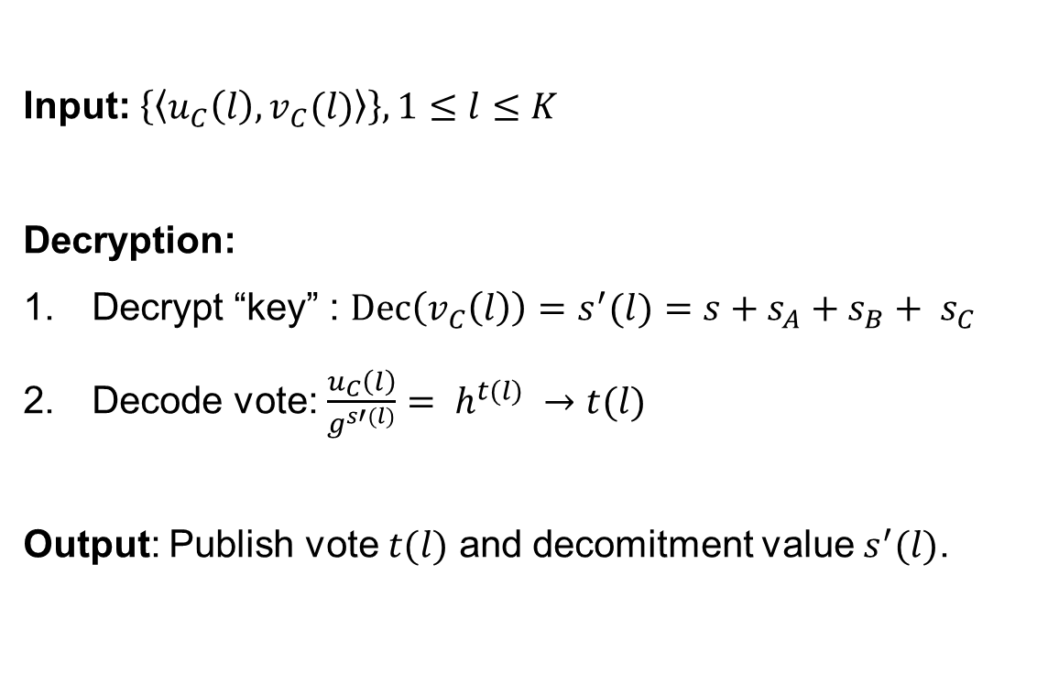
Decryption
Input: $\left\{\left\langle u_{C}\left(l\right), v_{C}(l)\right\rangle \right\},1≤l≤K$
Decryption:
Decrypt “key” : $Dec\left(v_{C}\left(l\right)\right)=s^{′}(l)=s+s_{A}+s_{B}+ s_{C}$
Decode vote: $\frac{u_{C}\left(l\right)}{g^{s′(l)}}= h^{t(l)} →t(l)$
Output: Publish vote $t(l)$ and decomitment value $s^{′}(l)$.

Slide 20




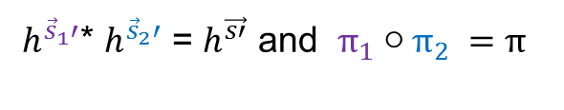

Public Verification – Cut-and-choose
Permutation: ${{π_{ }}^{ }}^{ }$, Recoding: $u_{A}=\left\langle u∗C(0,\vec{s^{′}})\right\rangle$
Input $u$
Output $u_{A}$
Show knowledge of $π_{ }$and $\vec{s}′$
Probability of doing an undetected modification for $b$ iterations is
$$\frac{1}{2^{b}}$$
1. Generate and publish intermediate batch
2. Challenge: “left” or “right”
3. If “left” publish $π_{1}$ and ${\vec{s}}_{1}′$ ,if “right” publish ${π_{2}}^{ }$und ${\vec{s}}_{2}′$
Less efficient. Thus RBV for large input sets.
4. Check and
5. Repeat
${π_{1}}^{ }$, ${\vec{s}}_{1}′$
${π_{2}}^{ }$, ${\vec{s}}_{2}′$
Input
Intermediate Batch
Output
${ h}^{{\vec{s}}_{1}′}$* $h^{{\vec{s}}_{2}′}$ = $h^{\vec{s′}}$ and ${π_{1}○{π_{2}}^{ }=π_{ }}^{ }$
Notes:
Kazue Sako und Joe Kilian 95
Split Ballot 2010

Slide 21















Private Verification– Cut-and-choose
Permutation: $π$, Recoding: $u_{A}=\left\langle u∗C(0,\vec{s^{′}})\right\rangle$
Input $u$
Output $u_{A}$
Input $v$
Output${ v}_{A}$
Permutation: $π$, Recoding: $v_{A}= \left\langle v∗Enc\left(\vec{s^{′}},\vec{r′}\right)\right\rangle$
Show knowledge of $π_{ }, \vec{s′}$ and $\vec{r′}$
$π_{1}$, ${\vec{s}}_{1}$
$π_{2}$, ${\vec{s}}_{2}$
Input $u$
Intermediate Batch${u′}_{A}$
Output $u_{A}$
Input $v$
Note: Message space must match for Commitment and Encryption Scheme.
Intermediate Batch${v′}_{A}$
Output $v_{A}$
${π_{1}}^{ }$, ${\vec{s}}_{1}$ , $\vec{r_{1}}$
${π_{2}}^{ }$, ${\vec{s}}_{2}$ , $\vec{r_{2}}$
Notes:
Kazue Sako und Joe Kilian 95
Split Ballot 2010
Es werden Commitments zu den Permutationen veröffentlicht. t kann nicht nach Bekanntgabe der Challenge „angepasst“ werden ohne den Diskreten-Logarithmus zu berechnen.

Slide 22
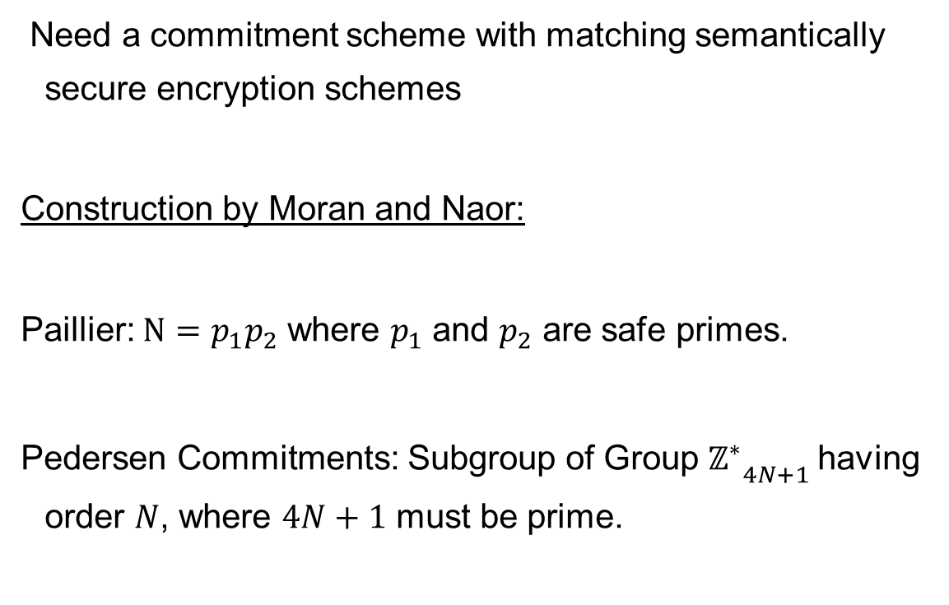
Parameters
Need a commitment scheme with matching semantically secure encryption schemes
Construction by Moran and Naor:
Paillier: $N=p_{1}p_{2}$ where $p_{1}$ and $p_{2}$ are safe primes.
Pedersen Commitments: Subgroup of Group ${{ℤ_{}^{∗}}_{4N+1}}_{ }$having order $N$, where $4N+1$ must be prime.

Slide 23
Application
Improving Helios with everlasting privacy towards the public

Slide 24
Helios
Introduced 2008 by Ben Adida
Web application for internet voting
Easy to use
Free of charge
Universal verifiability
Tool to support elections for companies, online groups, local clubs…
Princeton Undergraduate Student Government election 2009
President of the Université Catholique de Louvain 2009

Slide 25

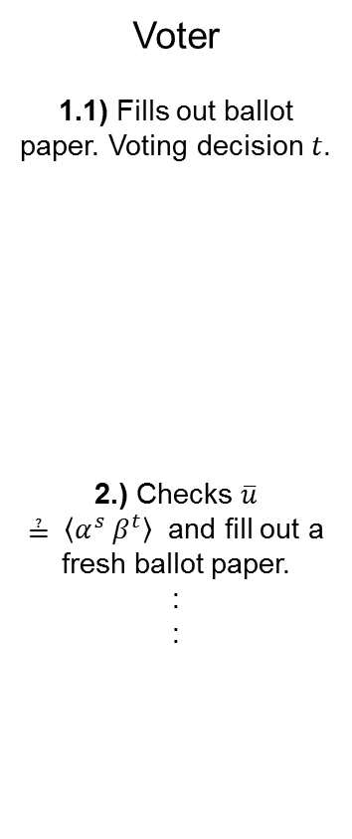

Helios providing everlasting privacy towards the public (1)
Voter
1.1) Fills out ballot paper. Voting decision $t$.
2.) Checks $\overline{u}$
$≟ \left\langle α^{s} β^{t}\right\rangle$ and fill out a fresh ballot paper.
:
:
$$t$$
$$\overline{u}$$
Want to audit encrypted vote $\overline{u}$ ?
Yes
$$s$$
:
:
Browser
1.2) Generate random number $s$and computes $\overline{u}$.
:
:

Slide 26
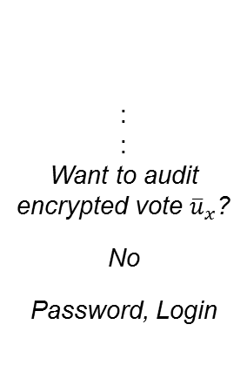


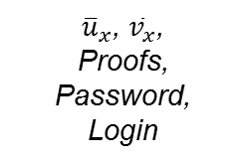
Helios providing everlasting privacy towards the public (2)
Voter
4.) Check if ${\overline{u}}_{x}$ appears
on the Bulletin Board
:
:
Want to audit encrypted vote ${\overline{u}}_{x}$?
No
Password, Login
Browser
3.) Generate proof of key equality.
${\overline{u}}_{x}$, ${\overline{v}}_{x}$,
Proofs, Password,
Login
Helios Server
$${\overline{u}}_{x}$$
Bulletin Board

Slide 27
Discussion
Prêt à Voter with everlasting privacy towards observers?

Slide 28
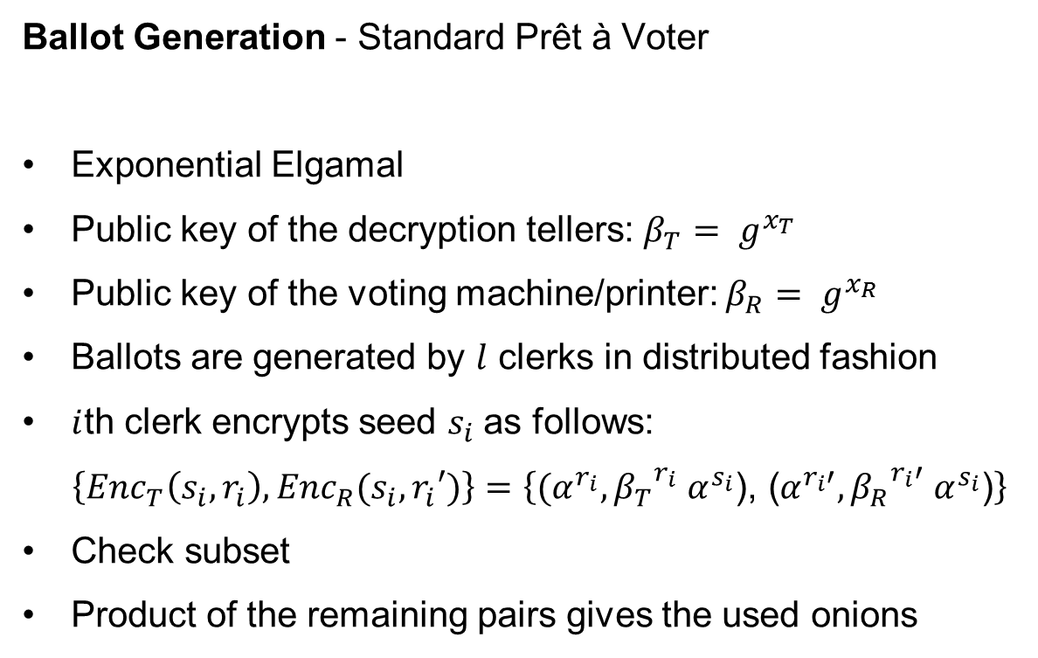
Discussion – 1.Step
Ballot Generation - Standard Prêt à Voter
Exponential Elgamal
Public key of the decryption tellers: $β_{T}= g^{x_{T}}$
Public key of the voting machine/printer: $β_{R}= g^{x_{R}}$
Ballots are generated by $l$ clerks in distributed fashion
$i$th clerk encrypts seed $s_{i}$as follows:
$\left\{{Enc}_{T}\left(s_{i},r_{i}\right),{Enc}_{R}(s_{i},r_{i}′)\right\}=\left\{{(α}^{r_{i}},{β_{T}}^{r_{i}} α^{s_{i}}\text{), (}α^{r_{i}′},{β_{R}}^{r_{i}′} α^{s_{i}}\text{)}\right\}$
Check subset
Product of the remaining pairs gives the used onions

Slide 29
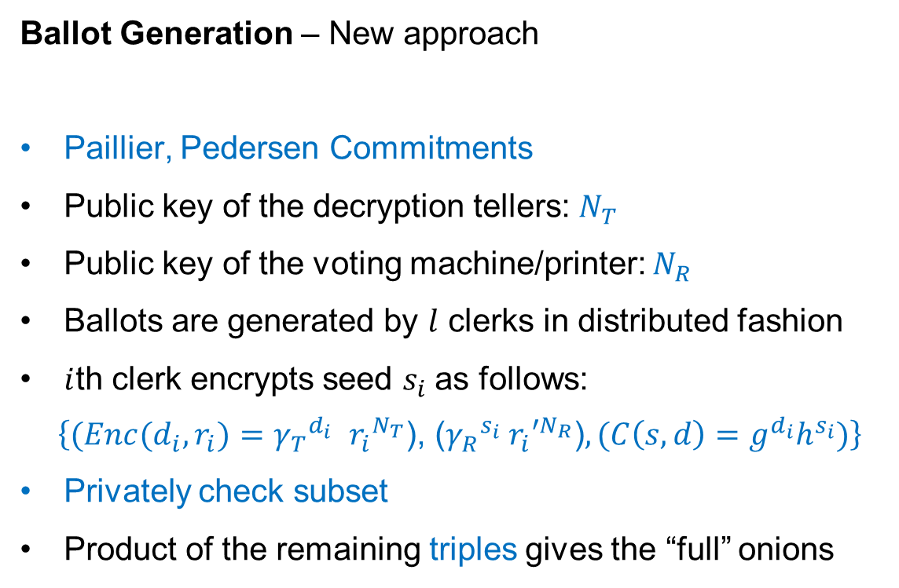
Discussion - 1. Step
Ballot Generation – New approach
Paillier, Pedersen Commitments
Public key of the decryption tellers: $N_{T}$
Public key of the voting machine/printer: $N_{R}$
Ballots are generated by $l$ clerks in distributed fashion
$i$th clerk encrypts seed $s_{i}$as follows:
$$\left\{(Enc(d_{i},r_{i}){{=γ}_{T}}^{d_{i}} {r_{i}}^{N_{T}}\text{), (}{γ_{R}}^{s_{i}} {r_{i}′}^{N_{R}}\text{)},({C\left(s,d\right)=g}^{d_{i}}h^{s_{i}})\right\}$$
Privately check subset
Product of the remaining triples gives the “full” onions

Slide 30


Discussion – 2. Step
Ballot Layout – Standard Prêt à Voter
Candidate B
Candidate C
Candidate D
Candidate E
Candidate A
$$\text{(}α^{r′},{β_{R}}^{r′} α^{s}\text{)}$$
$${(α}^{r},{β_{T}}^{r} α^{s}\text{)}$$

Slide 31


Discussion – 2. Step
Ballot Layout – New approach
Candidate B
Candidate C
Candidate D
Candidate E
Candidate A
$${γ_{R}}^{s} {r′}^{N_{R}}$$
$$g^{d}h^{s}$$

Slide 32
Discussion – Step 3
Ballot authentication – Standard Prêt à Voter
Candidate B
Candidate C
Candidate D
Candidate E
Candidate A
$${(α}^{r},{β_{T}}^{r} α^{s}\text{)}$$

Slide 33

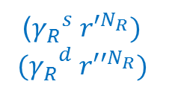
Discussion – 3. Step
Ballot authentication – New approach
Candidate B
Candidate C
Candidate D
Candidate E
Candidate A
(${γ_{R}}^{s} {r′}^{N_{R}})$
$${(γ_{R}}^{d} {r′′}^{N_{R}})$$
$$g^{d}h^{s}$$
$$d,s$$

Slide 34
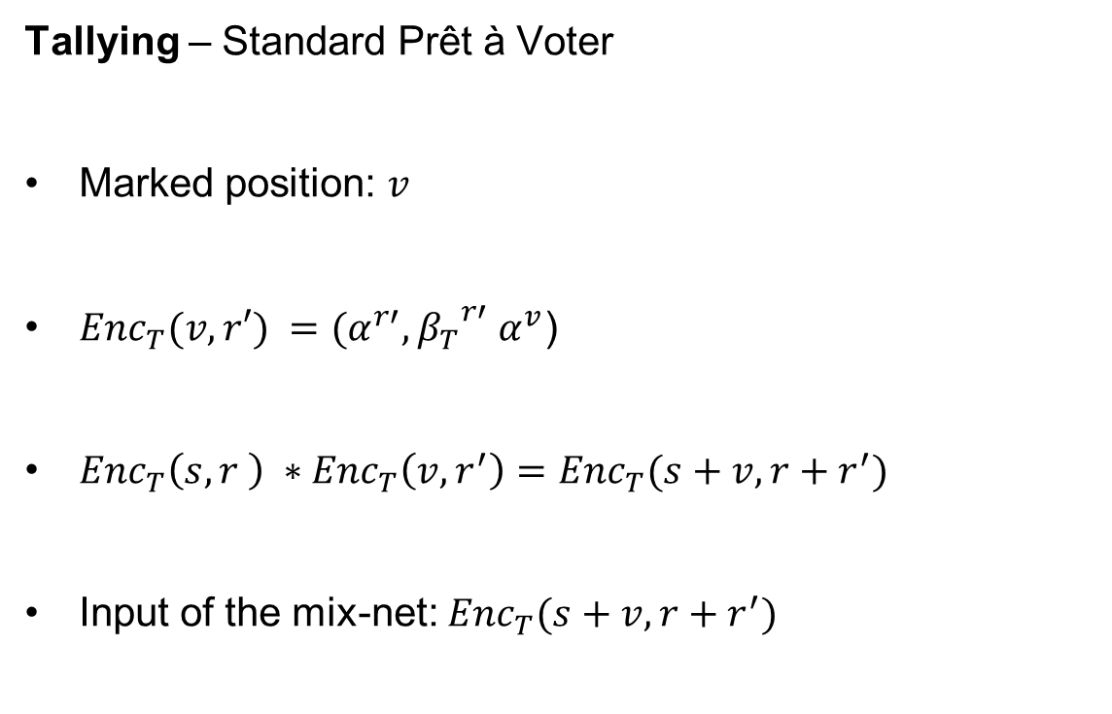
Discussion – 4. Step
Tallying – Standard Prêt à Voter
Marked position: $v$
${Enc}_{T}(v,r′) ={(α}^{r′},{β_{T}}^{r′} α^{v}\text{)}$
${Enc}_{T}\left(s,r \right) ∗{Enc}_{T}\left(v,r^{′}\right)={Enc}_{T}(s+v,r+r^{′})$
Input of the mix-net: ${Enc}_{T}(s+v,r+r^{′})$

Slide 35
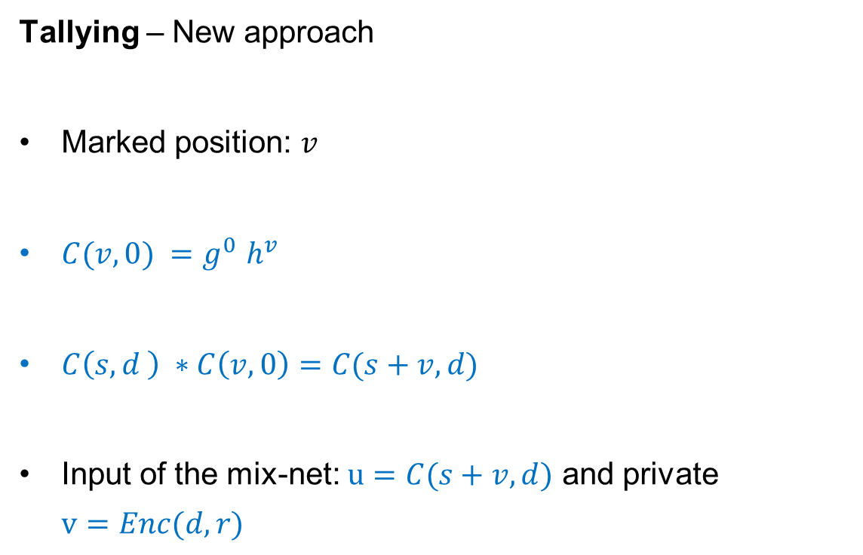
Discussion – 4. Step
Tallying – New approach
Marked position: $v$
$C(v,0) {=g}^{0}h^{v}$
$C\left(s,d \right) ∗C\left(v,0\right)=C(s+v,d)$
Input of the mix-net: $u=C(s+v,d)$ and private $v=Enc(d,r)$

Slide 36

Everlasting privacy of the Back End
$u$: encrypted vote (One-Time-Pad)
$v$: encrypted key (PK-Crypto)
A knows $\left\langle v\right\rangle$
Private
$$\left\langle v\right\rangle$$
$$\left\langle v_{A}\right\rangle$$
$$\left\langle v_{B}\right\rangle$$
$$\left\langle v_{C}\right\rangle$$
A
B
C
$$\left\langle u\right\rangle$$
$$\left\langle u_{A}\right\rangle$$
$$\left\langle u_{B}\right\rangle$$
$$\left\langle u_{C}\right\rangle$$
$$\left\langle t\right\rangle$$
Public Bulletin Board

Slide 37



















Secret sharing
$u,x$: encrypted vote and encrypted ID (One-Time-Pad)
$v,y$: encrypted keys for vote and ID (PK- Krypto)
$$\left\langle {v_{1},y}_{1}\right\rangle$$
$$\left\langle {v_{A1},y}_{A1}\right\rangle$$
$$\left\langle {v_{B1},y}_{B1}\right\rangle$$
$$\left\langle {v_{C1},y}_{C1}\right\rangle$$
A1
B1
C1
$$\left\langle u\right\rangle$$
$$=$$
$$\left\langle u_{1}\right\rangle$$
$$∗$$
$$\left\langle u_{2}\right\rangle$$
$$\left\langle v\right\rangle$$
$$=$$
$$\left\langle v_{1}\right\rangle$$
$$∗$$
$$\left\langle v_{2}\right\rangle$$
$$\left\langle {u_{1},x}_{1}\right\rangle$$
$$\left\langle {u_{A1},x}_{A1}\right\rangle$$
$$\left\langle {u_{B1},x}_{B1}\right\rangle$$
$$\left\langle {u_{C1},x}_{C1}\right\rangle$$
$$\left\langle t\right\rangle$$
Z
$$\left\langle {u_{2},x}_{2}\right\rangle$$
$$\left\langle {u_{A2},x}_{A2}\right\rangle$$
$$\left\langle {u_{B2},x}_{B2}\right\rangle$$
$$\left\langle {u_{C2},x}_{C2}\right\rangle$$
$$\left\langle {v_{2},y}_{2}\right\rangle$$
$$\left\langle {v_{A2},y}_{A2}\right\rangle$$
$$\left\langle {v_{B2},y}_{B2}\right\rangle$$
$$\left\langle {v_{C2},y}_{C2}\right\rangle$$
A2
B2
C2

Slide 38

















Verifizierung
$u,x$: encrypted vote and encrypted ID (One-Time-Pad)
$v,y$: encrypted keys for vote and ID (PK- Krypto)
$$\left\langle {v_{1},y}_{1}\right\rangle$$
Public verification
process
$$\left\langle {v_{A1},y}_{A1}\right\rangle$$
$$\left\langle {v_{B1},y}_{B1}\right\rangle$$
$$\left\langle {v_{C1},y}_{C1}\right\rangle$$
A1
B1
C1
Private verification process
$$\left\langle {u_{1},x}_{1}\right\rangle$$
$$\left\langle {u_{A1},x}_{A1}\right\rangle$$
$$\left\langle {u_{B1},x}_{B1}\right\rangle$$
$$\left\langle {u_{C1},x}_{C1}\right\rangle$$
$$\left\langle t\right\rangle$$
Z
$$\left\langle {u_{1},x}_{1}\right\rangle$$
$$\left\langle {u_{A2},x}_{A2}\right\rangle$$
$$\left\langle {u_{B2},x}_{B2}\right\rangle$$
$$\left\langle {u_{C2},x}_{C2}\right\rangle$$
$$\left\langle {v_{2},y}_{2}\right\rangle$$
$$\left\langle {v_{A2},y}_{A2}\right\rangle$$
$$\left\langle {v_{B2},y}_{B2}\right\rangle$$
$$\left\langle {v_{C2},y}_{C2}\right\rangle$$
A2
B2
C2

Slide 39
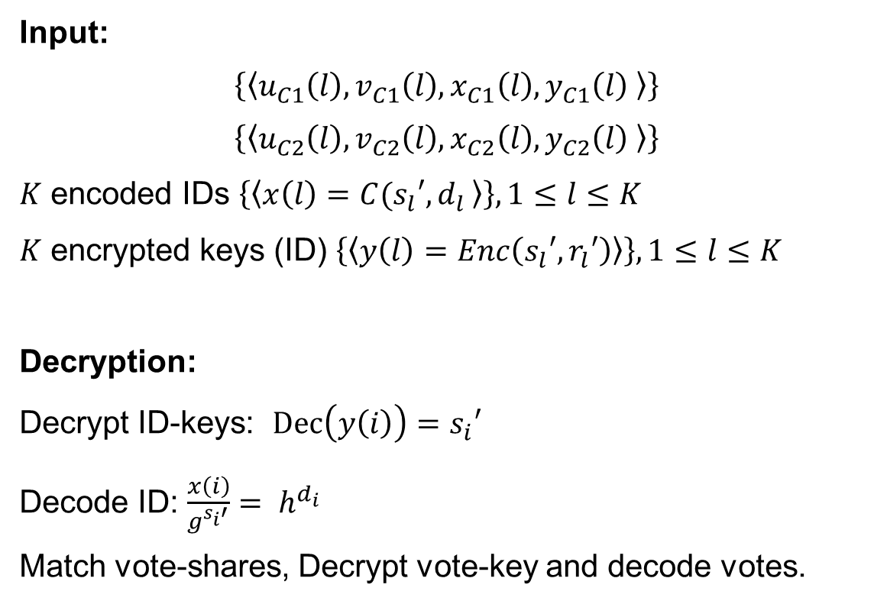
Decryption
Input:
$$\left\{\left\langle u_{C1}\left(l\right), v_{C1}\left(l\right),x_{C1}\left(l\right),y_{C1}\left(l\right) \right\rangle \right\}$$
$$\left\{\left\langle u_{C2}\left(l\right), v_{C2}\left(l\right),x_{C2}\left(l\right),y_{C2}\left(l\right) \right\rangle \right\}$$
$K$ encoded IDs $\left\{\left\langle x\left(l\right)=C(s_{l}′{,d}_{l}\right\rangle \right\},1≤l≤K$
$K$ encrypted keys (ID) $\left\{\left\langle y\left(l\right)=Enc\left(s_{l}′,r_{l}′\right)\right\rangle \right\}, 1≤l≤K$
Decryption:
Decrypt ID-keys: $Dec\left(y\left(i\right)\right)=s_{i}′$
Decode ID: ${\frac{x\left(i\right)}{g^{s_{i}′}}= h}^{d_{i}}$
Match vote-shares, Decrypt vote-key and decode votes.

Slide 40
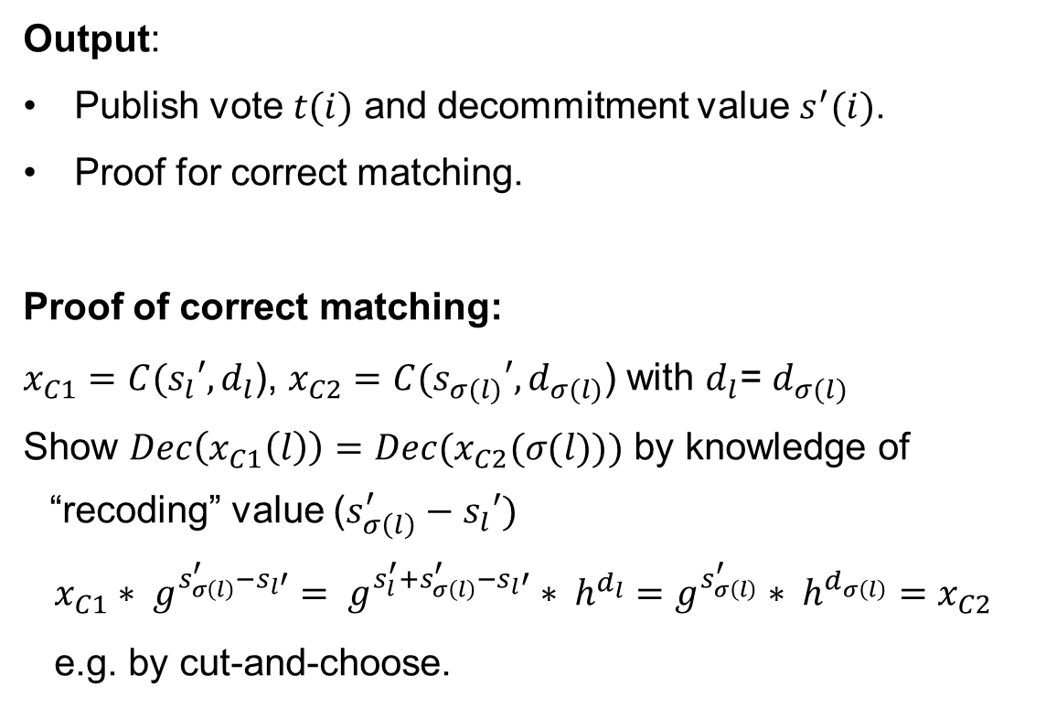
Decryption (2)
Output:
Publish vote $t(i)$ and decommitment value $s^{′}(i)$.
Proof for correct matching.
Proof of correct matching:
$x_{C1}=C(s_{l}′{,d}_{l}$), $x_{C2}=C(s_{σ(l)}′{,d}_{σ(l)}$) with $d_{l}$= $d_{σ(l)}$
Show $Dec\left(x_{C1}\left(l\right)\right)=Dec(x_{C2}(σ(l)))$ by knowledge of “recoding” value (${s_{σ\left(l\right)}^{′}−s}_{l}′)$
$x_{C1}∗ g^{{s_{σ\left(l\right)}^{′}−s}_{l}′}= g^{s_{l}^{′}+{s_{σ\left(l\right)}^{′}−s}_{l}′}∗ h^{d_{l}}=$ $g^{s_{σ\left(l\right)}^{′}}∗ h^{d_{σ\left(l\right)}}=$ $x_{C2}$
e.g. by cut-and-choose.

Slide 41



Secret sharing
$u$: encrypted vote and encrypted ID (One-Time-Pad)
$v$: encrypted keys for vote and ID (PK- Krypto)
$$\left\langle {v_{1},y}_{1}\right\rangle$$
$$\left\langle {v_{A1},y}_{A1}\right\rangle$$
$$\left\langle {v_{B1},y}_{B1}\right\rangle$$
$$\left\langle {v_{C1},y}_{C1}\right\rangle$$
A1
B1
C1
$$\left\langle u\right\rangle$$
$$=$$
$$\left\langle u_{1}\right\rangle$$
$$∗$$
$$\left\langle u_{2}\right\rangle$$
$$\left\langle v\right\rangle$$
$$=$$
$$\left\langle v_{1}\right\rangle$$
$$∗$$
$$\left\langle v_{2}\right\rangle$$
$$\left\langle {u_{1},x}_{1}\right\rangle$$
$$\left\langle {u_{A1},x}_{A1}\right\rangle$$
$$\left\langle {u_{B1},x}_{B1}\right\rangle$$
$$\left\langle {u_{C1},x}_{C1}\right\rangle$$
$$\left\langle t\right\rangle$$
Z
$$\left\langle {u_{2},x}_{2}\right\rangle$$
$$\left\langle {u_{A2},x}_{A2}\right\rangle$$
$$\left\langle {u_{B2},x}_{B2}\right\rangle$$
$$\left\langle {u_{C2},x}_{C2}\right\rangle$$
$$\left\langle {v_{2},y}_{2}\right\rangle$$
$$\left\langle {v_{A2},y}_{A2}\right\rangle$$
$$\left\langle {v_{B2},y}_{B2}\right\rangle$$
$$\left\langle {v_{C2},y}_{C2}\right\rangle$$
A2
B2
C2

Slide 42
Future Work
Front- End
Evaluation of Pereira’s “efficient unconditional bit commitment scheme with matching homomorphic encryption scheme based on elliptic curves”.
Evaluation of Groth‘s “Zero-Knowledge Shuffle Argument”.
Notes:
Further improvement durch Reviews. Kryptopraktikum. Große s.
Front-End: Papier (e.g. PaV-Open Task Secret Sharing, Split Ballot), verteilte Wahlgeräte

Slide 43
Thank you
Questions?

