Slide 1
Vote privacy: models and cryptographic underpinnings
Bogdan Warinschi
University of Bristol

Slide 2
Aims and objectives
Models are useful, desirable
Cryptographic proofs are not difficult
Have y’all do one cryptographic proof
Have y’all develop a zero-knowledge protocol
Have y’all prove one property for a zero-knowledge protocol

Slide 3
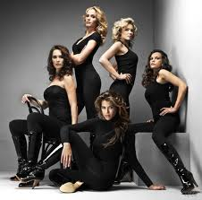
Models

Slide 4
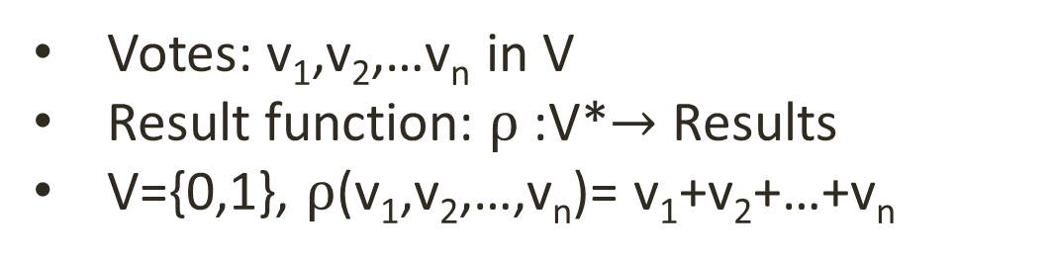
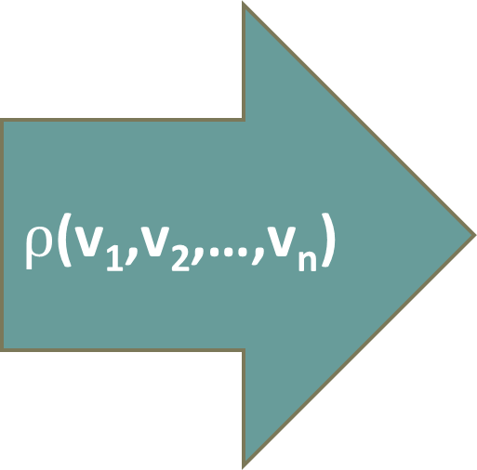
Voting scheme
v₁
$ρ$(v₁,v₂,…,v_{n})
v₂
v_{n}
Votes: v₁,v₂,…v_{n} in V
Result function: $ρ$:V*$→$ Results
V={0,1}, $ρ$(v₁,v₂,…,v_{n})= v₁+v₂+…+v_{n}

Slide 5
Wish list
Eligibility: only legitimate voters vote; each voter votes once
Fairness: voting does not reveal early results
Verifiability: individual, universal
Privacy: no information about the individual votes is revealed
Receipt-freeness: a voter cannot prove s/he voted in a certain way
Coercion-resistance: a voter cannot interact with a coercer to prove that s/he voted in a certain way

Slide 6
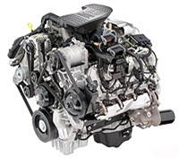
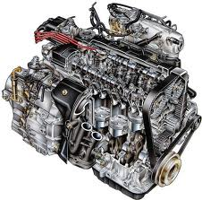
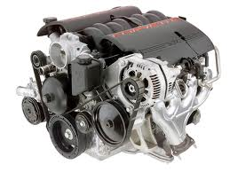
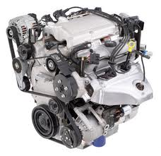
Design-then-break paradigm
…attack found
…attack found
…attack found
…no attack found
Guarantees: no attack has been found yet

Slide 7
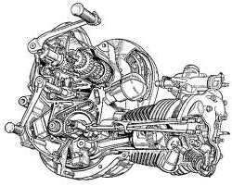
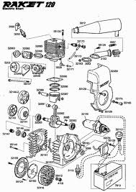
Security models
Mathematical descriptions:
What a system is
How a system works
What is an attacker
What is a break
Advantages: clarify security notion; allows for security proofs (guarantees within clearly established boundaries)
Shortcomings: abstraction – implicit assumptions, details are missing (e.g. trust in hardware, side-channels)

Slide 8
This talk
Privacy-relevant cryptographic primitives
  Asymmetric encryption
  Noninteractive zero-knowledge proofs
Privacy-relevant techniques
  Homomorphicity
  Rerandomization
  Threshold cryptography
Security models for encryption
Security models for vote secrecy (Helios)

Slide 9
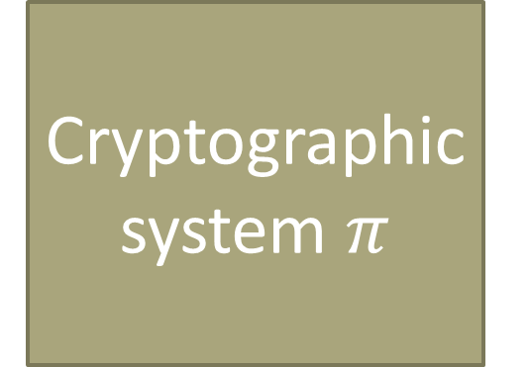
Cryptographic security models
Cryptographic system $π$

Slide 10
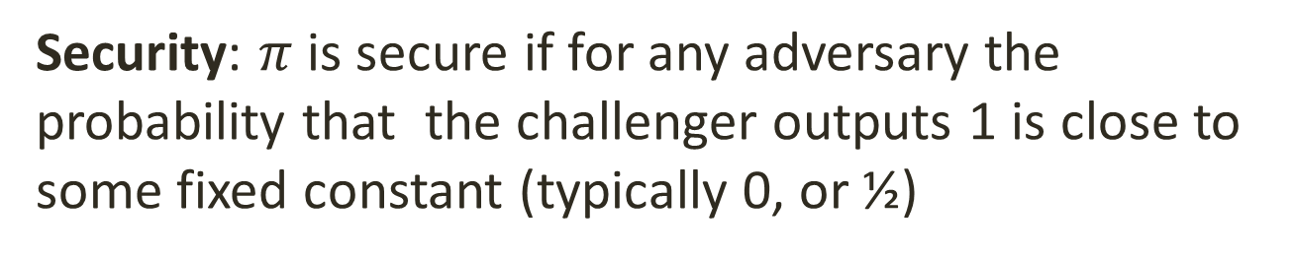

Game based models
$$π$$
Challenger
Query
Answer
0/1
Security: $π$ is secure if for any adversary the probability that the challenger outputs 1 is close to some fixed constant (typically 0, or ½)

Slide 11
Asymmetric Encryption schemes

Slide 12
Syntax
Setup(ν): fixes parameters for the scheme
KG(params): randomized algorithm that generates (PK,SK)
ENC_{PK}(m): randomized algorithm that generates an encryption of m under PK
DEC_{SK}(C): deterministic algorithm that calculates the decryption of C under sk

Slide 13
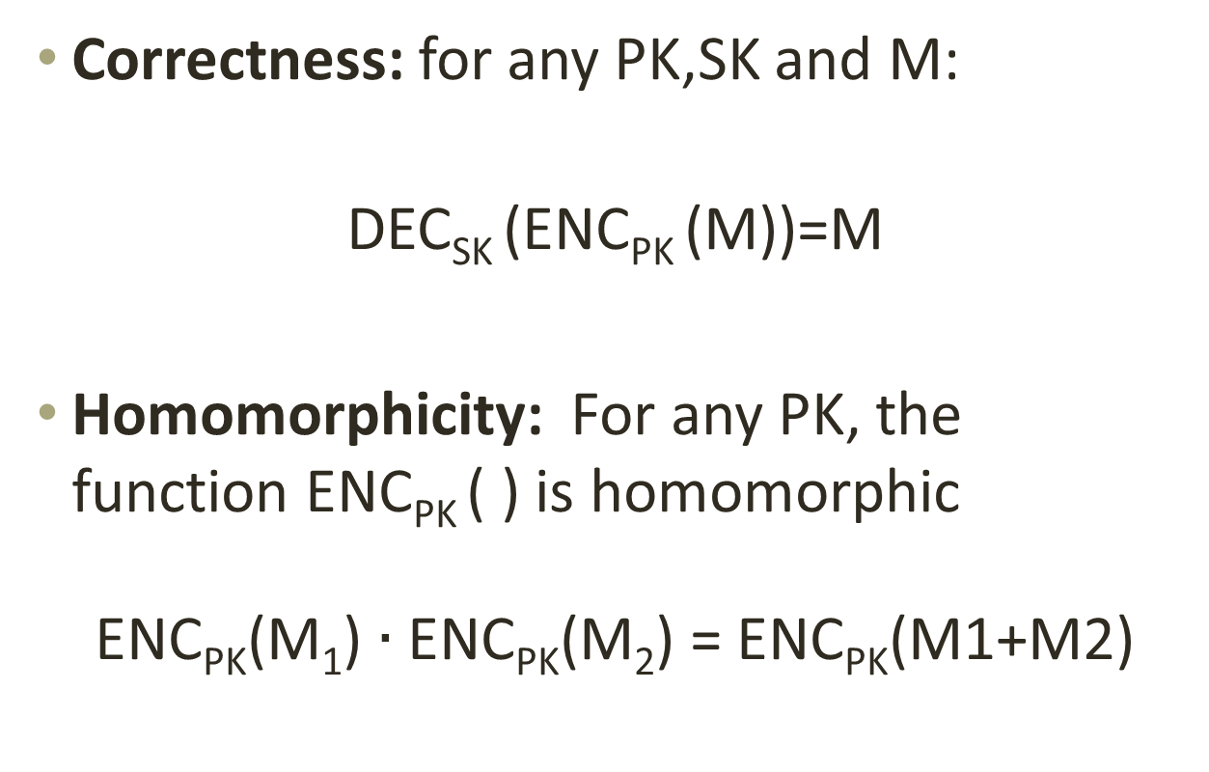
Functional properties
Correctness: for any PK,SK and M:
DEC_{SK} (ENC_{PK} (M))=M
Homomorphicity: For any PK, the function ENC_{PK} ( ) is homomorphic
ENC_{PK}(M₁) $∙$ ENC_{PK}(M₂) = ENC_{PK}(M1+M2)

Slide 14
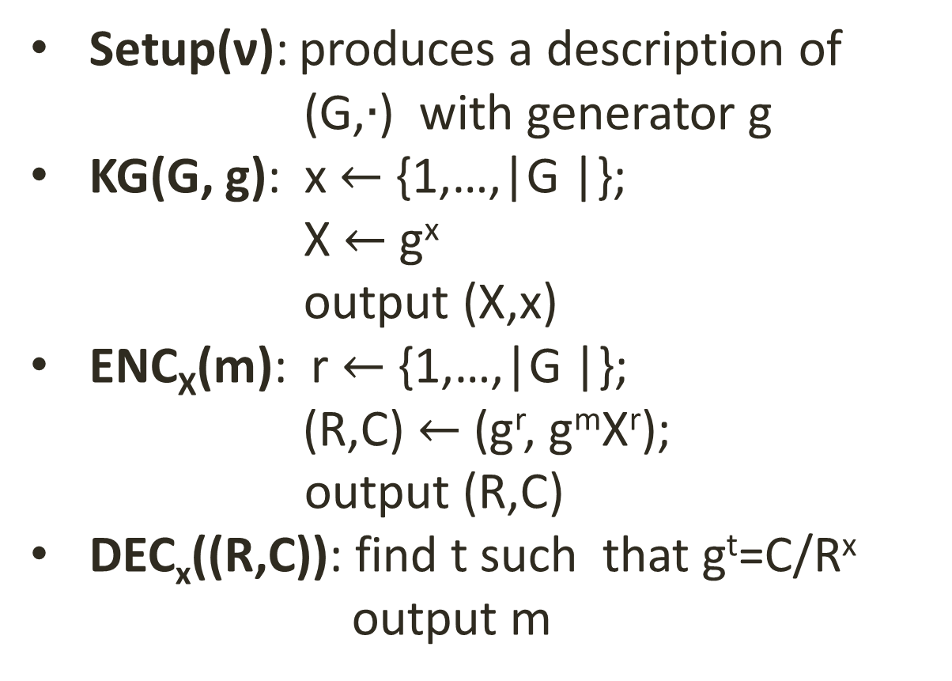
(exponent) ElGamal
Setup(ν): produces a description of (G,$∙$) with generator g
KG(G, g): x $←${1,…,|G |};
X $←$g^{x}
output (X,x)
ENC_{X}(m): r $←${1,…,|G |};
(R,C) $←$(g^{r}, g^{m}X^{r});
output (R,C)
DEC_{x}((R,C)): find t such that g^{t}=C/R^{x}
output m

Slide 15
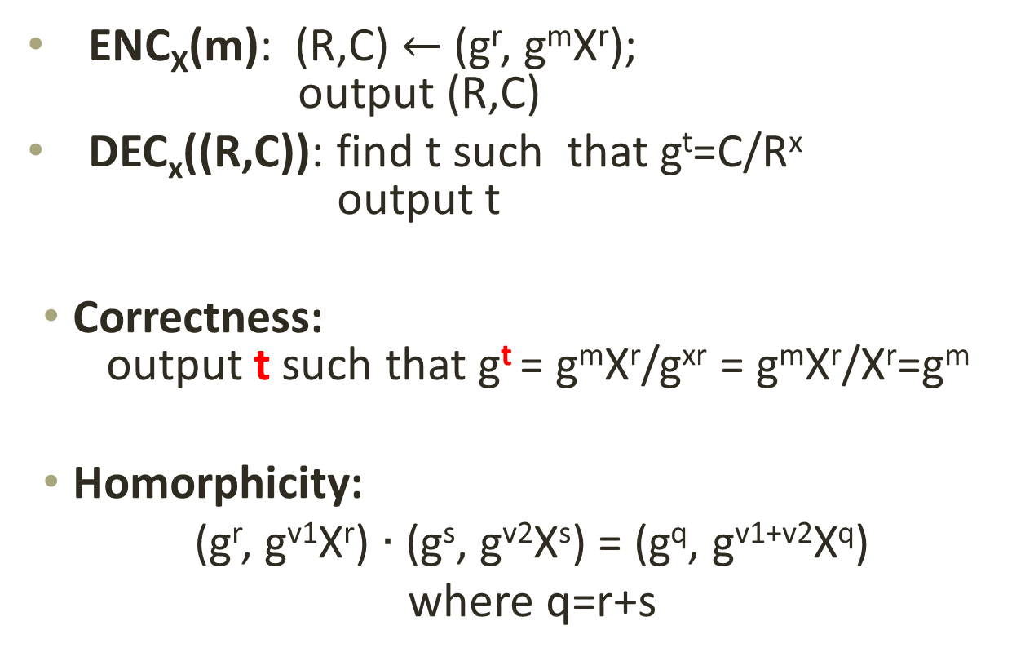
Functional properties
ENC_{X}(m): (R,C) $←$(g^{r}, g^{m}X^{r});
output (R,C)
DEC_{x}((R,C)): find t such that g^{t}=C/R^{x}
output t
Correctness:
output t such that g^{t} = g^{m}X^{r}/g^{xr} = g^{m}X^{r}/X^{r}=g^{m}
Homorphicity:
(g^{r}, g^{v1}X^{r}) $∙$ (g^{s}, g^{v2}X^{s}) = (g^{q}, g^{v1+v2}X^{q})
where q=r+s

Slide 16



IND-CPA
$π$is IND-CPA secure if Pr[win] ~ 1/2
$$Security for π=(Setup,Kg,Enc,Dec)$$
$$π$$
Public Key
par $←$ Setup()
(PK,SK ) $←$ Kg (par)
b$←\{0,1\}$
C $←$Enc_{PK}(M_{b})
win $←$ d=b
Good definition?
PK
M₀,M_{I}
Theorem:If the DDH problem is hard in G then the ElGamal encryption scheme is IND-CPA secure.
C
Guess d
win

Slide 17
Single pass voting scheme

Slide 18
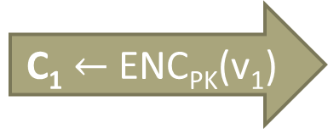
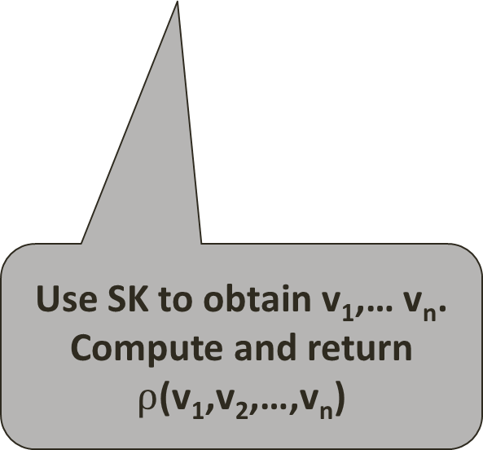
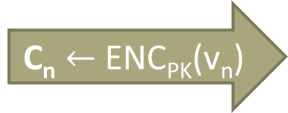
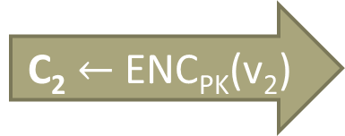
Informal
PK
BB
P₁: v₁
C₁ $←$ ENC_{PK}(v₁)
SK
C₁
P₂: v₂
C₂ $←$ ENC_{PK}(v₂)
C₂
Use SK to obtain v₁,… v_{n}. Compute and return $ρ$(v₁,v₂,…,v_{n})
P_{n}: v_{n}
C_{n} $←$ ENC_{PK}(v_{n})
C_{n}

Slide 19
Syntax of SPS schemes
Setup(ν): generates (x,y,BB) secret information for tallying, public information parameters of the scheme, initial BB
Vote(y,v): the algorithm run by each voter to produce a ballot b
Ballot(BB,b): run by the bulleting board; outputs new BB and accept/reject
Tallying(BB,x): run by the tallying authorities to calculate the final result

Slide 20
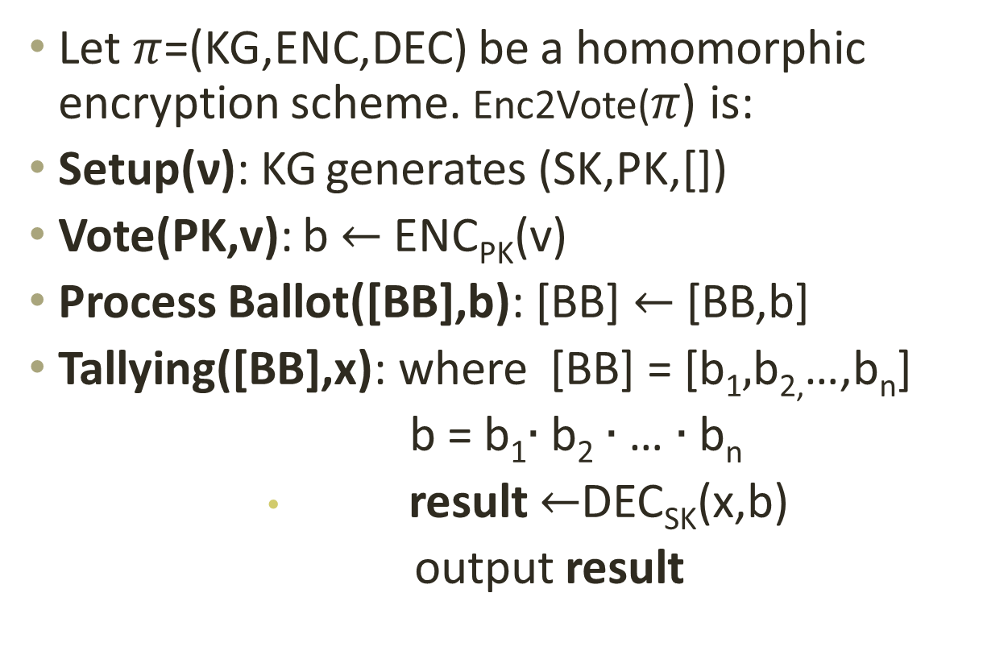
An implementation: Enc2Vote
$\text{Let} π$=(KG,ENC,DEC) be a homomorphic encryption scheme. Enc2Vote($π$) is:
Setup(ν): KG generates (SK,PK,[])
Vote(PK,v): b $←$ ENC_{PK}(v)
Process Ballot([BB],b): [BB] $←$ [BB,b]
Tallying([BB],x): where [BB] = [b₁$,$b_{2,}…,b_{n}]
b = b₁$∙$b₂ $∙$… $∙$b_{n}
              result $←$DEC_{SK}(x,b)
              output result

Slide 21
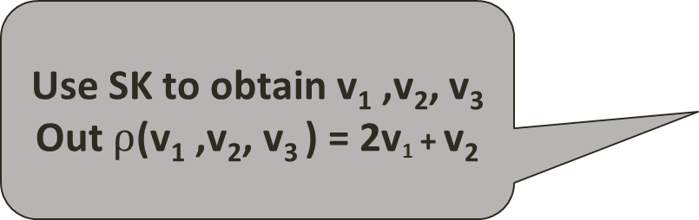

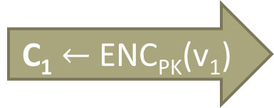
Attack against privacy
Use SK to obtain v₁ ,v₂, v₃ Out $ρ$(v₁ ,v₂, v₃ ) = 2v₁ + v₂
PK
BB
P₁: v₁
C₁ $←$ ENC_{PK}(v₁)
SK
C₁
P₂: v₂
C₂ $←$ ENC_{PK}(v₂)
C₂
FIX: weed out equal ciphertexts
P₃
C₁
C₁
Assume that votes are either 0 or 1
If the result is 0 or 1 then v₁ was 0, otherwise v₁ was 1
Notes:
Add the 2v1+v2 as the result

Slide 22
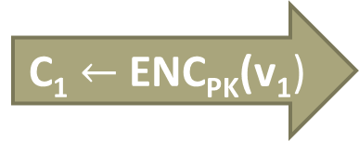
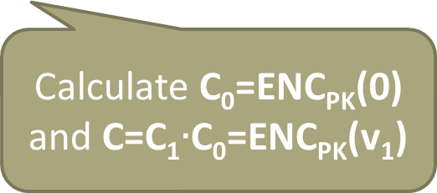
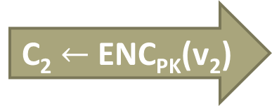
New attack
Use SK to obtain v₁ ,v₂, v₃ Out $ρ$(v₁ ,v₂, v₃ ) = 2v₁ + v₂
PK
BB
P₁: v₁
C₁ $←$ ENC_{PK}(v₁)
SK
C₁
P₂: v₂
C₂ $←$ ENC_{PK}(v₂)
C₂
FIX: Make sure ciphertexts cannot be mauled and weed out equal ciphertexts
P₃
C
C
Calculate C₀=ENC_{PK}(0)
and C=C₁$∙$C₀=ENC_{PK}(v₁)

Slide 23
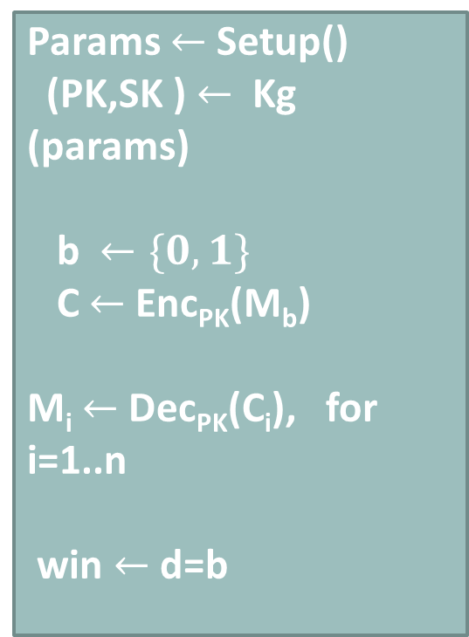

Non-malleable encryption (NM-CPA)
Good definition?
$$Nonnmalleability of π=(Setup,Kg,Enc,Dec)$$
$$π$$
Public Key
Params $←$ Setup()
(PK,SK ) $←$ Kg (params)
b$←\{0,1\}$
C $←$Enc_{PK}(M_{b})
M_{i} $←$Dec_{PK}(C_{i}), for i=1..n
win $←$ d=b
PK
M₀,M₁
C
C₁, C₂ …,C_{n}
M₁, M₂,…,M_{n}
Guess d
win

Slide 24
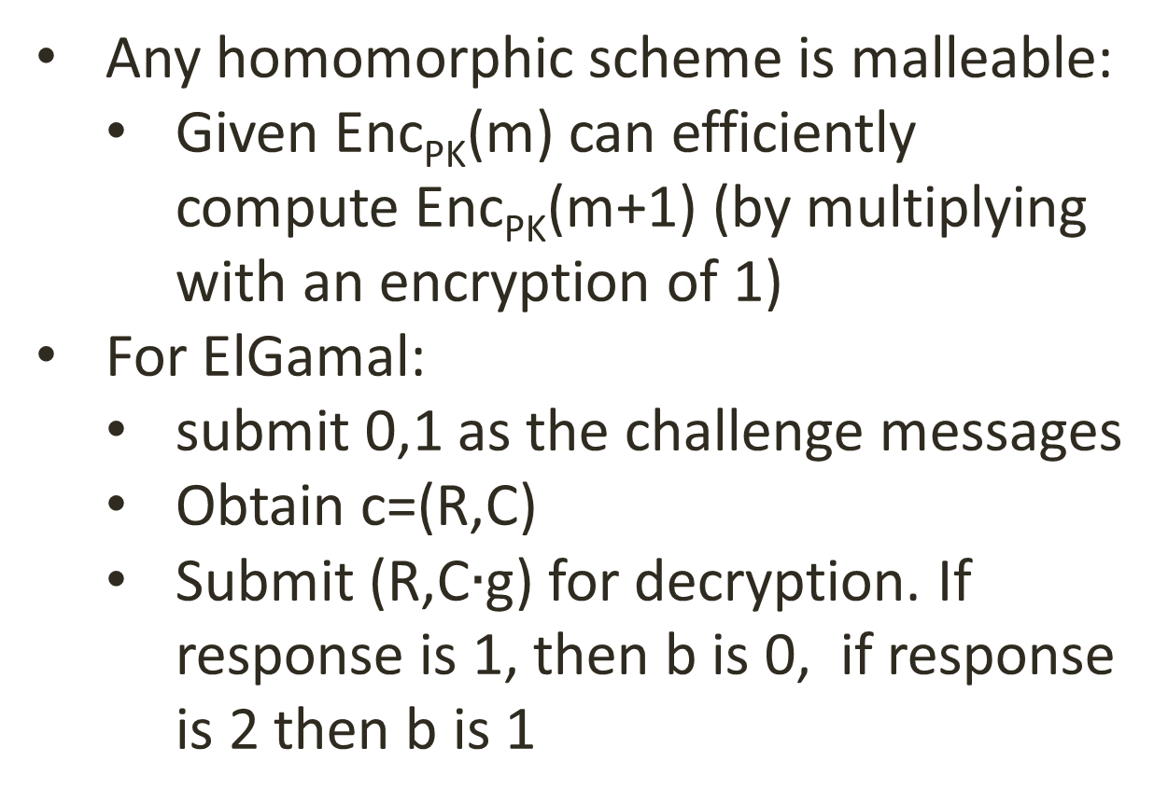
ElGamal is not non-malleable
Any homomorphic scheme is malleable:
  Given Enc_{PK}(m) can efficiently compute Enc_{PK}(m+1) (by multiplying with an encryption of 1)
For ElGamal:
  submit 0,1 as the challenge messages
  Obtain c=(R,C)
  Submit (R,C$∙$g) for decryption. If response is 1, then b is 0, if response is 2 then b is 1

Slide 25

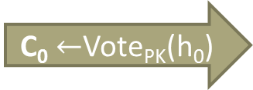



Ballot secrecy for SPS [BCPSW11]
BB₀
BB₁
PK
SK
Sees BB_{b}
C₀ $←$Vote_{PK}(h₀)
C₀
h₀,h₁
C₁ $←$ Vote_{PK}(h₁)
C₁
C
C
C
C
result
r$esult←$Tally_{SK}(BB₀)
d
win $←$ d=b
b $←\{0,1\}$
win

Slide 26
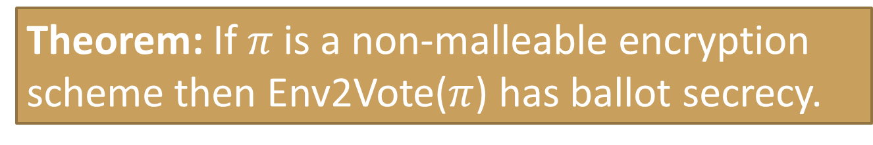

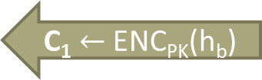
Theorem: If $π \text{i}$s a non-malleable encryption scheme then Env2Vote($π$) has ballot secrecy.
h₀,h₁
PK
PK
PK
h₀,h₁
BB
C₁ $←$ ENC_{PK}(h_{b})
C₁
C
C
SK
C₁, C₂,…, C_{t}
r$esult←$F(H₀,V)
v₁, v₂,…, v_{t}
result
d
d

Slide 27
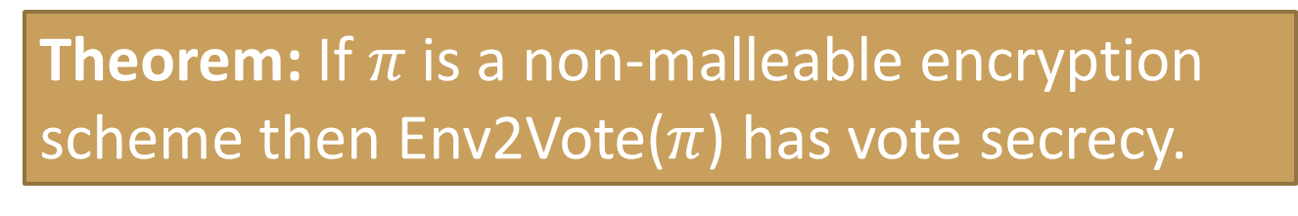
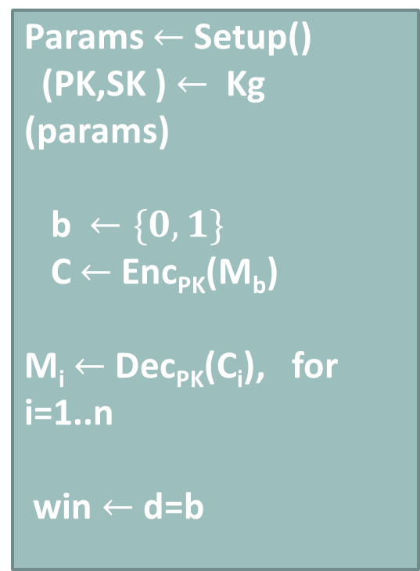
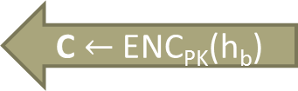
Theorem: If $π \text{i}$s a non-malleable encryption scheme then Env2Vote($π$) has vote secrecy.
h₀,h₁
PK
PK
PK
Params $←$ Setup()
(PK,SK ) $←$ Kg (params)
b$←\{0,1\}$
C $←$Enc_{PK}(M_{b})
M_{i} $←$Dec_{PK}(C_{i}), for i=1..n
win $←$ d=b
h₀,h₁
BB
C $←$ ENC_{PK}(h_{b})
C
C’
C’
SK
C₁, C₂,…, C_{t}
r$esult←$F(H₀,V)
v₁, v₂,…, v_{t}
result
d
d

Slide 28
Zero Knowledge Proofs

Slide 29
Interactive proofs
Accept/
Reject
X
Wants to convince the Verifier that something is true about X. Formally that: Rel(X,w) for some w.
Variant: the prover actually knows such a w
X
M₁
w
M₂
Examples:
Rel_{g,h} ((X,Y),z) iff X=g^{z} and Y=h^{z}
Rel_{g,X} ((R,C),r) iff R=g^{r} and C=X^{r}
Rel_{g,X} ((R,C),r) iff R=g^{r} and C/g=X^{r}
Rel_{g,X} ((R,C),r) iff (R=g^{r} and C=X^{r} ) or (R=g^{r} and C/g=X^{r})
M₃
M_{n}
Prover
Verifier
Notes:
TODO: examples of useful X

Slide 30
Properties (informal)
Completeness: an honest prover always convinces an honest verifier of the validity of the statement
Soundness: a dishonest prover can cheat only with small probability
Zero knowledge: no other information is revealed
Proof of knowledge: can extract witness from a successful prover

Slide 31
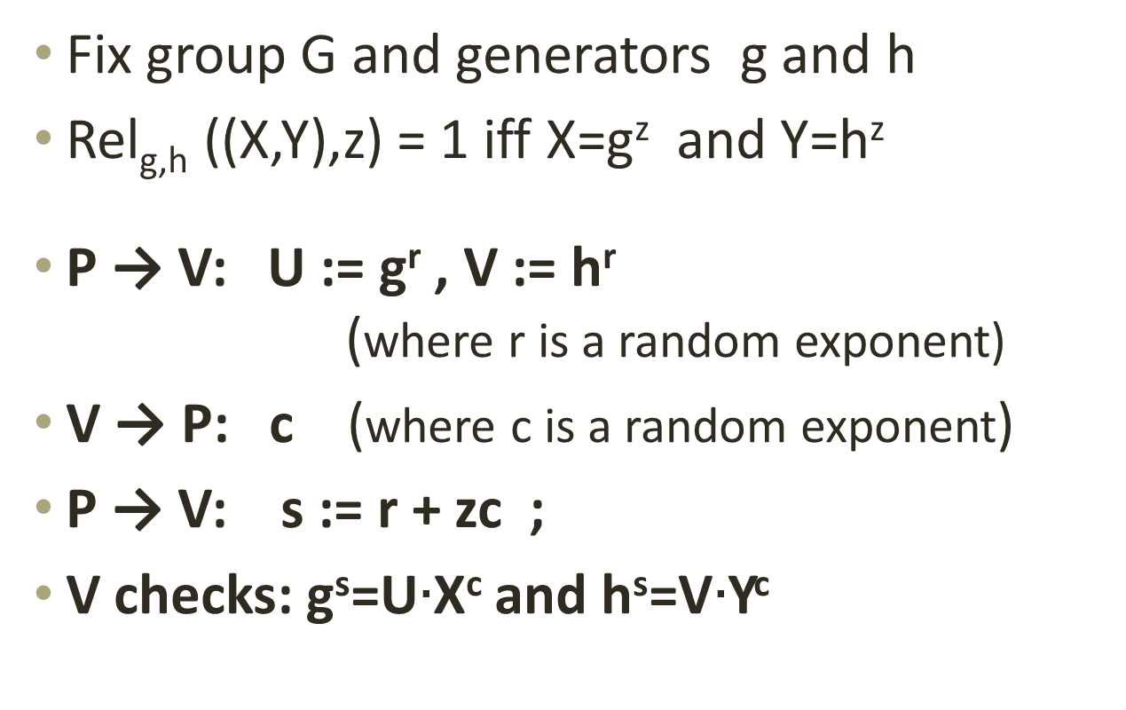
Equality of discrete logs [CP92]
Fix group G and generators g and h
Rel_{g,h} ((X,Y),z) = 1 iff X=g^{z} and Y=h^{z}
P → V: U := g^{r} , V := h^{r}
(where r is a random exponent)
V → P: c (where c is a random exponent)
P → V: s := r + zc ;
V checks: g^{s}=U$∙$X^{c} and h^{s}=V$∙$Y^{c}

Slide 32
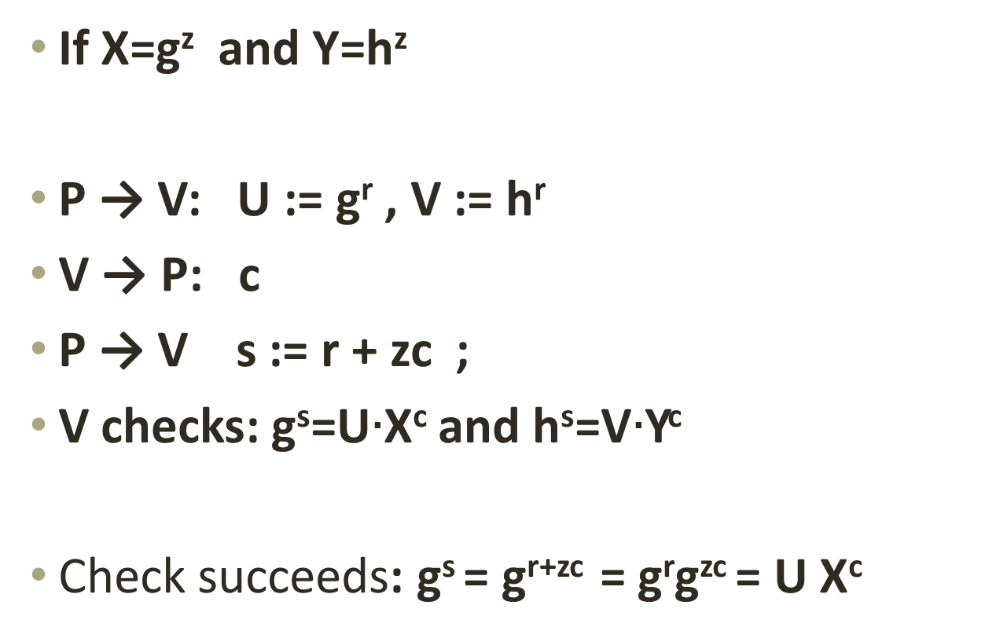
Completeness
If X=g^{z} and Y=h^{z}
P → V: U := g^{r} , V := h^{r}
V → P: c
P → V s := r + zc ;
V checks: g^{s}=U$∙$X^{c} and h^{s}=V$∙$Y^{c}
Check succeeds: g^{s} = g^{r+zc} = g^{r}g^{zc} = U X^{c}

Slide 33
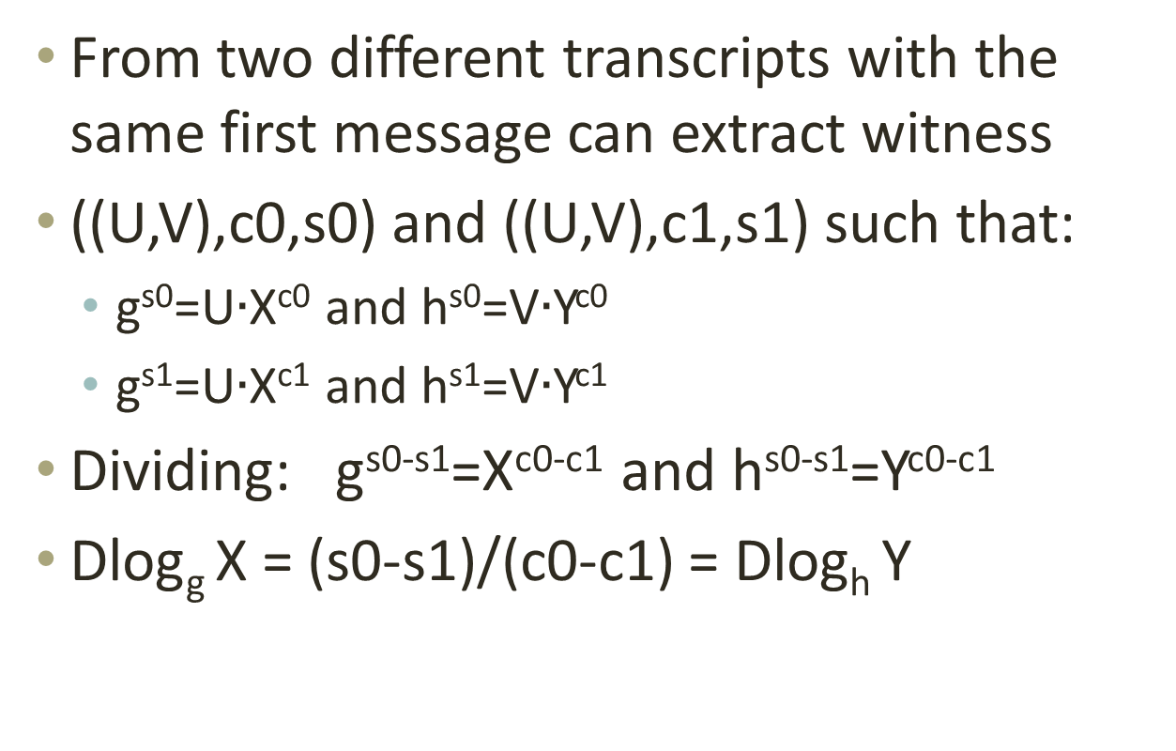
(Special) Soundness
From two different transcripts with the same first message can extract witness
((U,V),c0,s0) and ((U,V),c1,s1) such that:
  g^{s0}=U$∙$X^{c0} and h^{s0}=V$∙$Y^{c0}
  g^{s1}=U$∙$X^{c1} and h^{s1}=V$∙$Y^{c1}
Dividing: g^{s0-s1}=X^{c0-c1} and h^{s0-s1}=Y^{c0-c1}
Dlog_{g} X = (s0-s1)/(c0-c1) = Dlog_{h} Y

Slide 34
(HV) zero-knowledge
X,w
X
X
R
R
Rel(X,w)
c
c
s
s
There exists a simulator SIM that produces
transcripts that are indistinguishable from
those of the real execution.

Slide 35
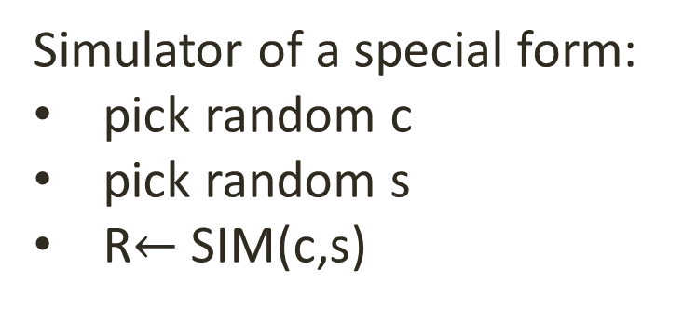
Special zero-knowledge
X,w
X
X
R
R
Rel(X,w)
c
c
s
s
Simulator of a special form:
pick random c
pick random s
R$←$ SIM(c,s)

Slide 36
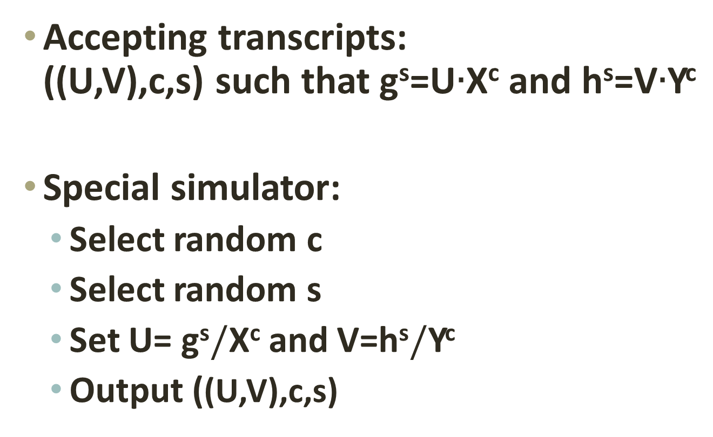
Special zero-knowledge for CP
Accepting transcripts:
((U,V),c,s) such that g^{s}=U$∙$X^{c} and h^{s}=V$∙$Y^{c}
Special simulator:
  Select random c
  Select random s
  Set U= g^{s}$/$X^{c} and V=h^{s}$/$Y^{c}
  Output ((U,V),c,s)

Slide 37
OR-proofs [CDS95,C96]
X
Y,w
Y
X,w
R1
R2
Rel1(X,w)
c1
Rel2(Y,w)
c2
s1
s2
Design a protocol for Rel3(X,Y,w) where:
Rel3(X,Y,w) iff Rel1(X,w) or Rel2(Y,w)

Slide 38
OR-proofs
X,Y
X,Y,w
R1
R2
c1
c2
c
s1
s2

Slide 39
OR-proofs
X,Y
X,Y,w
R1
R2
Rel1(X,w)
c1=c-c2
c2
c
s1
s2

Slide 40
OR-proofs
X,Y
X,Y,w
R1
R2
Rel1(X,w1)
c1=c-c2
c2
c
c1,s1
c2,s2
To verify: check that c1+c2=c and that (R1,c1,s1) and (R2,c2,s2) are accepting transcripts for the respective relations.

Slide 41

Non-interactive proofs
X,w
X
$$π$$
Prover
Verifier

Slide 42
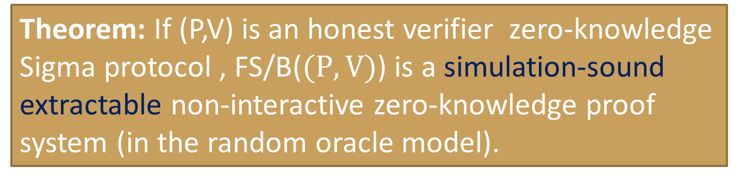
The Fiat-Shamir/Blum transform
Theorem: If (P,V)$\text{i}$s an honest verifier zero-knowledge Sigma protocol , FS/B($(P,V)$) is a simulation-sound extractable non-interactive zero-knowledge proof system (in the random oracle model).
X,w
X
X,w
X
R
R
Rel(X,w)
c
c=H(X,R)
s
s
The proof is (R,s).
To verify: compute c=H(R,s). Check (R,c,s) as before

Slide 43
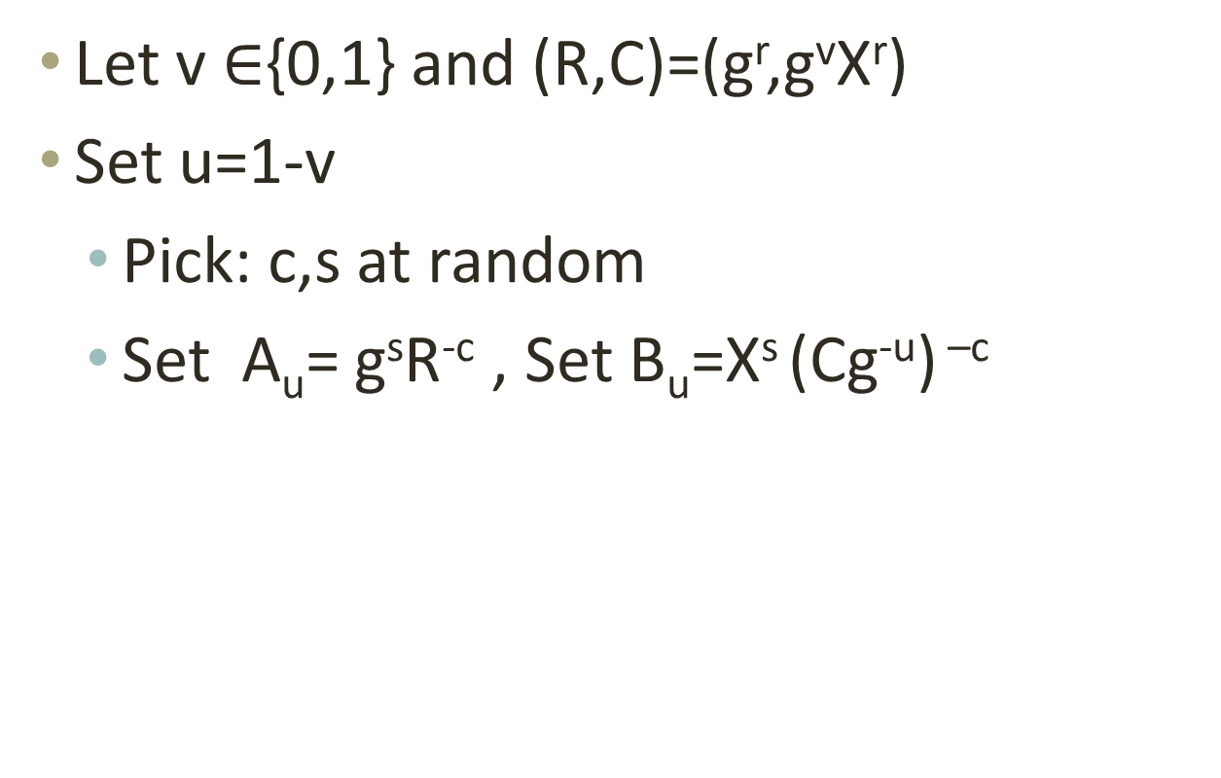
ElGamal + PoK
Let v $∈${0,1} and (R,C)=(g^{r},g^{v}X^{r})
Set u=1-v
  Pick: c,s at random
  Set A_{u}= g^{s}R^{-c} , Set B_{u}=X^{s} (Cg^{-u}) ^{–c}

Slide 44
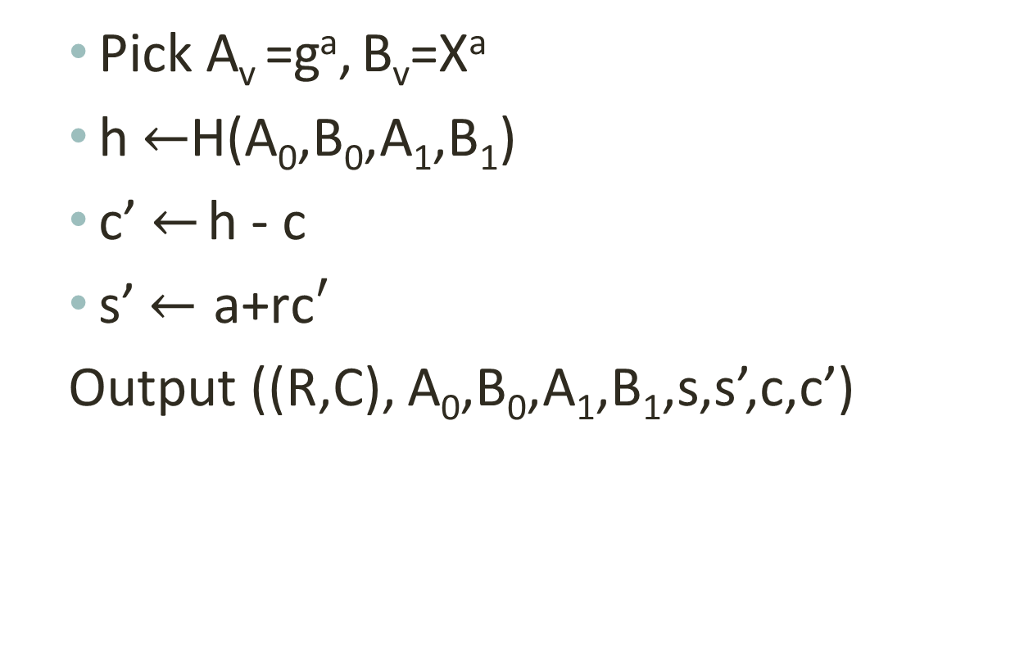
ElGamal + PoK
Theorem: ElGamal+PoK as defined is NM-CPA, in the random oracle model.
  Pick A_{v} =gª, B_{v}=Xª
  h $←$H(A₀,B₀,A₁,B₁)
  c’ $←$ h - c
  s’ $←\text{a}\text{+}\text{rc}′$
  Output ((R,C), A₀,B₀,A₁,B₁,s,s’,c,c’)
Theorem: Enc2Vote(ElGamal+PoK) has vote secrecy, in the random oracle model.

Slide 45
Random oracle [BR93,CGH98]
Unsound heuristic
There exists schemes that are secure in the random oracle model for which any instantiation is insecure
Efficiency vs security

Slide 46
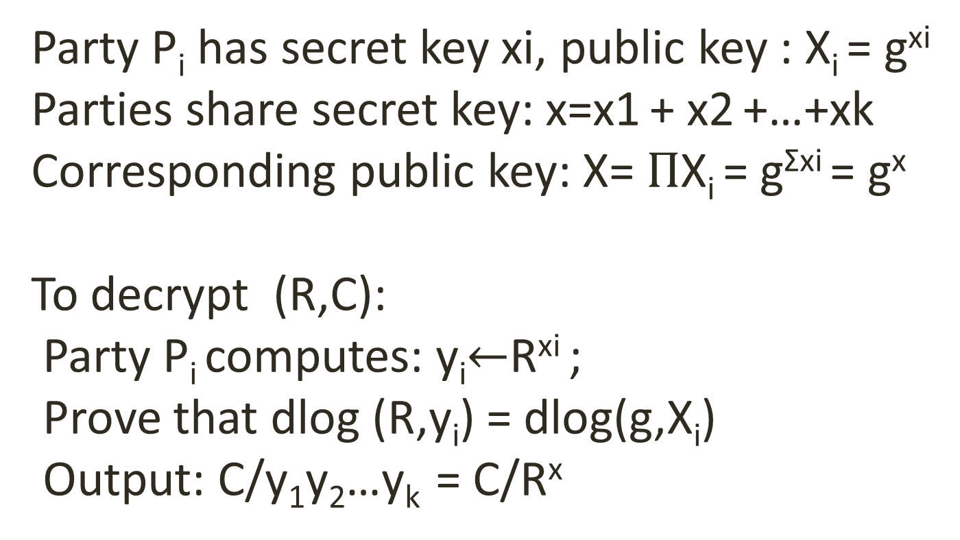
Exercise: Distributed ElGamal decryption
Party P_{i} has secret key xi, public key : X_{i} = g^{xi}
Parties share secret key: x=x1 + x2 +…+xk
Corresponding public key: X=$Π$X_{i} = g^{Σxi} = g^{x}
To decrypt (R,C):
Party P_{i} computes: y_{i}$←$R^{xi} ;
Prove that dlog (R,y_{i}) = dlog(g,X_{i})
Output: C/y₁y₂…y_{k} = C/R^{x}
Design a non interactive zero knowledge proof that Pi behaves correctly

Slide 47
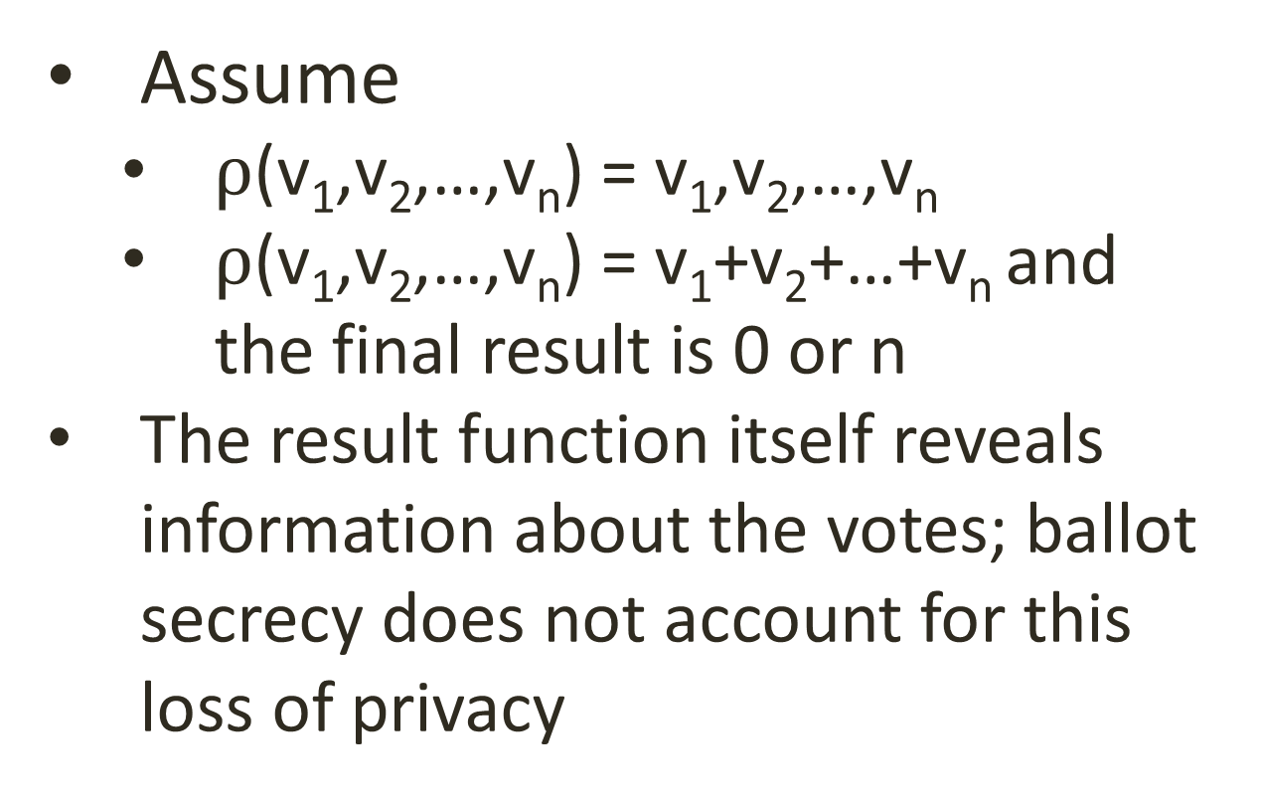
Ballot secrecy vs. vote privacy
Assume
  $ρ$(v₁,v₂,…,v_{n}) = v₁,v₂,…,v_{n}
  $ρ$(v₁,v₂,…,v_{n}) = v₁+v₂+…+v_{n} and the final result is 0 or n
The result function itself reveals information about the votes; ballot secrecy does not account for this loss of privacy

Slide 48
An Information theoretic approach To vote Privacy [BCPW12?]

Slide 49
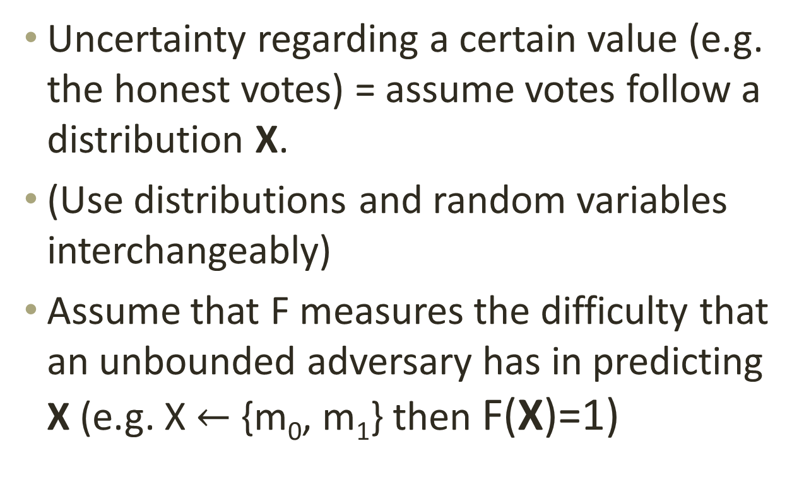
Information theory
Uncertainty regarding a certain value (e.g. the honest votes) = assume votes follow a distribution X.
(Use distributions and random variables interchangeably)
Assume that F measures the difficulty that an unbounded adversary has in predicting X (e.g. X $←$ {m₀, m₁} then F(X)=1)

Slide 50
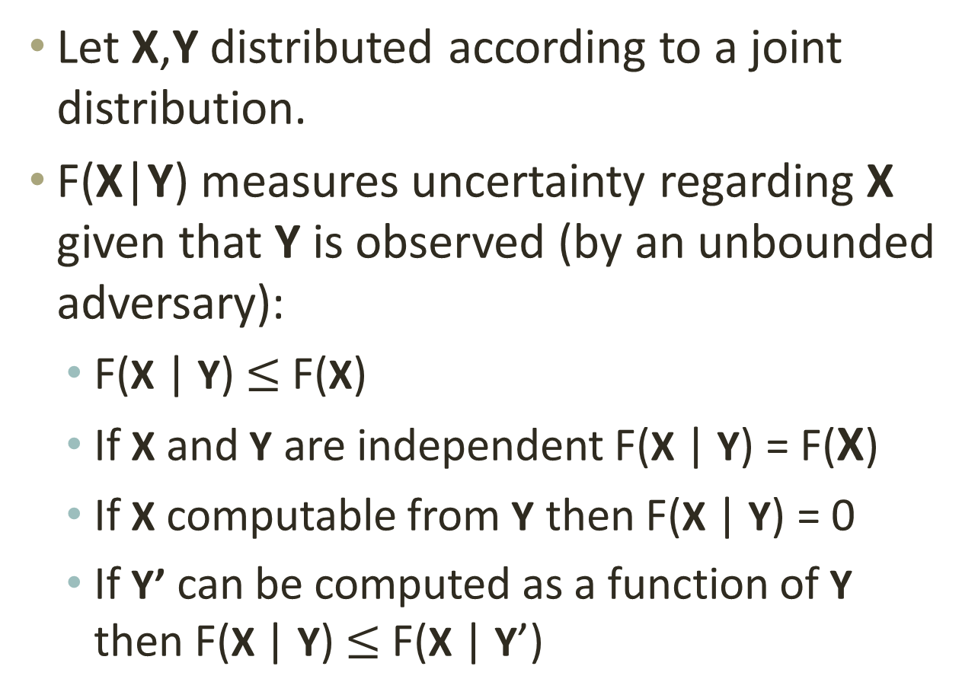
Conditional privacy measure
Let X,Y distributed according to a joint distribution.
F(X|Y) measures uncertainty regarding X given that Y is observed (by an unbounded adversary):
  F(X | Y) $≤$ F(X)
  If X and Y are independent F(X | Y) = F(X)
  If X computable from Y then F(X | Y) = 0
  If Y’ can be computed as a function of Y then F(X | Y) $≤$ F(X | Y’)

Slide 51
Computational variant
F(M| Enc_{PK}(M)) = ?

Slide 52
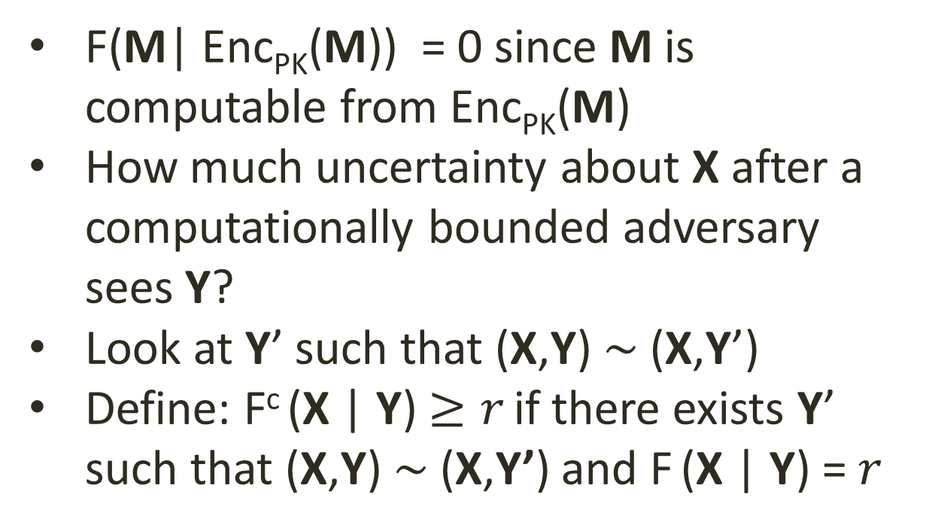
Computational variant
F(M| Enc_{PK}(M)) = 0 since M is computable from Enc_{PK}(M)
How much uncertainty about X after a computationally bounded adversary sees Y?
Look at Y’ such that (X,Y) $\sim$ (X,Y’)
Define: F^{c} (X | Y) $≥r$ if there exists Y’ such that (X,Y) $\sim$ (X,Y’) and F (X | Y) =$r$

Slide 53
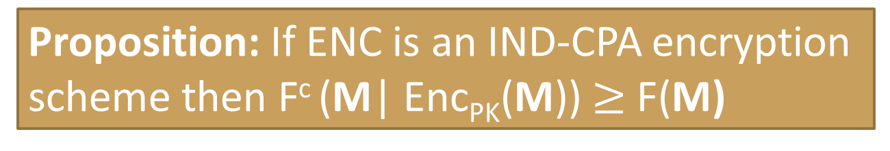
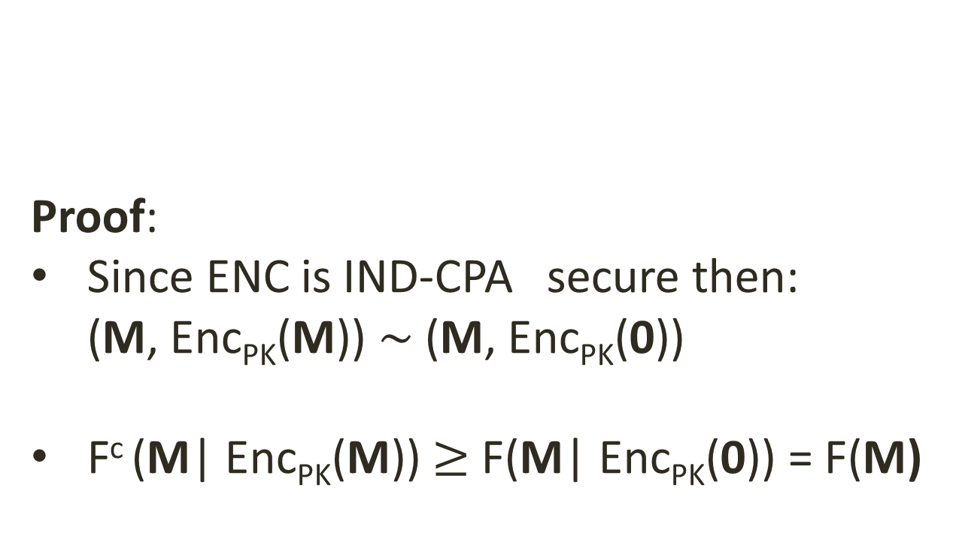
Example
Proof:
Since ENC is IND-CPA secure then:
(M, Enc_{PK}(M)) $\sim$ (M, Enc_{PK}(0))
F^{c} (M| Enc_{PK}(M)) $≥$F(M| Enc_{PK}(0)) = F(M)
Proposition: If ENC is an IND-CPA encryption scheme then F^{c} (M| Enc_{PK}(M)) $≥$ F(M)

Slide 54
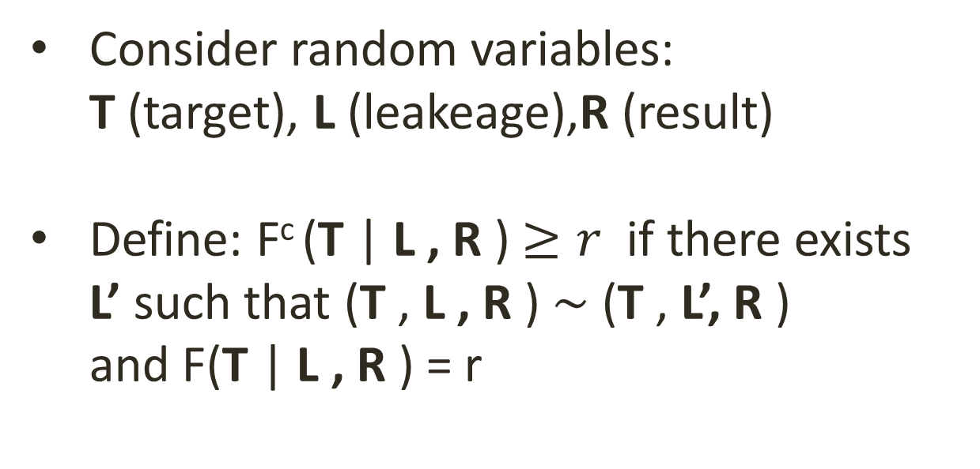
Variation
Consider random variables:
T (target), L (leakeage),R (result)
Define: F^{c} (T | L , R ) $≥r$ if there exists
L’ such that (T , L , R ) $\sim$ (T , L’, R )
and F(T | L , R ) = r

Slide 55
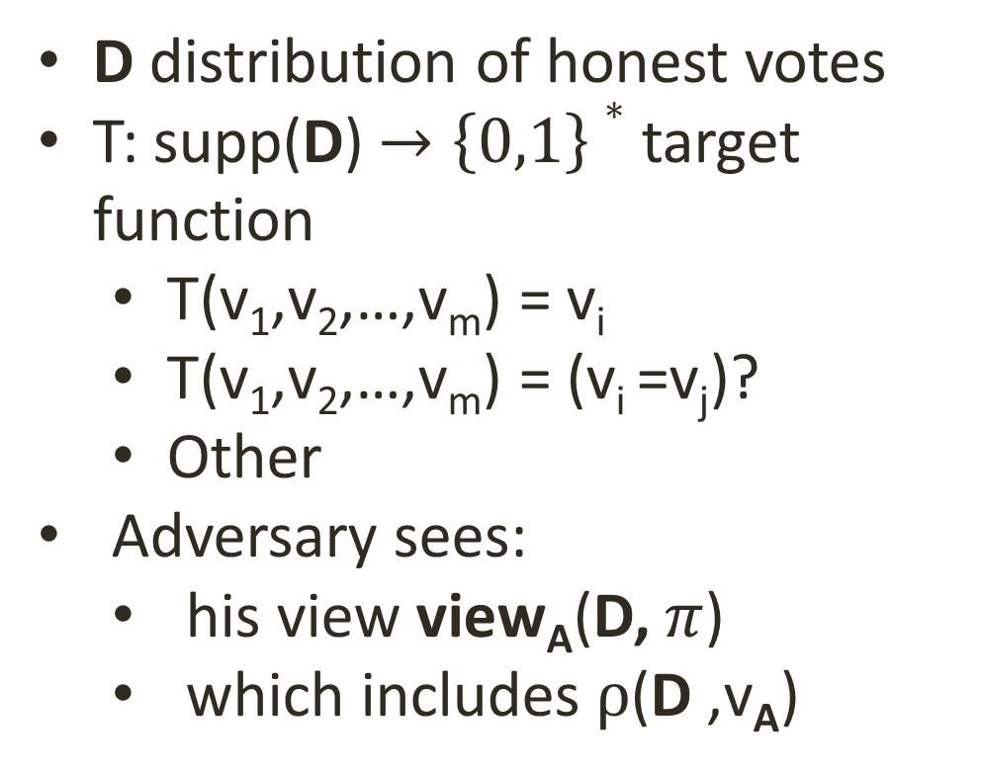
Application to voting
D distribution of honest votes
T: supp(D)$→\left\{0,1\right\}∗$ target function
  T(v₁,v₂,…,v_{m}) = v_{i}
  T(v₁,v₂,…,v_{m}) = (v_{i} =v_{j})?
  Other
Adversary sees:
  his view view_{A}(D, $π$)
  which includes $ρ$(D ,v_{A})

Slide 56

Measure(s) for vote privacy
Definition: For D distribution on honest votes, T target function, and $π$ protocol, define:
M^{c}(T,D,$π$) = inf_{A} F^{c} (T(D)|view_{A} (D,$π$), $ρ$(D ,v_{A}))
Can also define an information theoretic notion:
M(T,D,$π$) = inf_{A} F(T(D)|view_{A} (D,$π$), $ρ$(D ,v_{A}))

Slide 57

Privacy of idealized protocols
Proposition: M (T,D,$ρideal$) = inf_{A} F(T(D)| $ρ$(D ,v_{A}))

Slide 58


Recall: vote secrecy for SPS
BB₀
BB₁
PK
SK
Sees BB_{b}
C₀ $←$ ENC_{PK}(h₀)
C₀
h₀,h₁
C₁ $←$ ENC_{PK}(h₁)
C₁
C
C
C
C
result
r$esult←$Tally_{SK}(BB₀)
d
win $←$ d=b
win

Slide 59




Recall: vote secrecy for SPS
Proposition: Secure SPS implies that $∀\text{A}$
(D,view_{A} (D,$π$), $ρ$(D ,v_{A})) ~ (D,view_{A} (0,$π$), $ρ$(D ,v_{A}))
BB₀
BB₁
PK
SK
Corollary: Secure SPS $π$for $ρ$implies that
M^{c}(T,D,$π$) = M (T,D,$ρideal$)
Sees BB_{b}
C₀ $←$ ENC_{PK}(0)
C₀
h₀,0
C₁ $←$ ENC_{PK}(h₁)
C₁
D
Proof:
M^{c}(T,D,$π$) =
inf_{A} F^{c} (T(D)|view_{A} (D,$π$), $ρ$(D ,v_{A})) $≥$
inf_{A} F (T(D)|view_{A} (0,$π$), $ρ$(D ,v_{A})) =
inf_{A} F (T(D)|$ρ$(D ,v_{A})) = M (T,D,$ρideal$)
C
C
C
C
result
r$esult←$Tally_{SK}(BB₀)
d
win $←$ d=b
win

Slide 60
Relation with d-privacy
Set F to be average min-entropy

Slide 61
Choice of entropy
Average min-entropy: measures the probability that an observer guesses the target function of the votes
Min min-entropy: measures the probability that an observer guesses the target function of the votes for the worst possible election outcome
Min Hartley entropy: measures the minimum number of values that the target function can take for any assignment of votes

Slide 62
NOT COVERED

Slide 63

Threshold decryption
Party P_{i} has (xi, X_{i}=g^{xi});
x=x1 + x2 +…+xk;
X=$Π$ X_{i} = g^{Σxi} = g^{x}
To decrypt (R,C):
P_{i}: y_{i}$←$R^{xi} ;
prove that dlog (y_{i},R) = dlog(g,X_{i})
Output: C/y₁y₂…y_{k} = C/R^{x}

Slide 64



Simulation-based models [Groth05]
$$π$$
$$π\text{ideal}$$
Security: $π$ is secure (as secure as $π$_{ideal}) if for any there exists a such that the overall outputs are indistinguishable

Slide 65
Games vs. simulation security
Games
  Not always intuitive
  Difficult to design: challenger/queries should reflect all potential uses of the system and permit access to all the information that can be gleaned
Simulation
  More intuitive (for simple systems)
  Too demanding (e.g. adaptive security)

Slide 66
Relation with d-privacy
Set F to be average min-entropy

Slide 67
Dolev-Yao models [DKR09]
Protocols specified in a process algebra (applied-pi calculus)
Vote secrecy:
P[vote1/v1, vote2/v2] ≈ P[vote2/v1, vote1/v2]
Abstraction?
Relation with the game-based definition?

Slide 68
Incoercibility/Receipt freeness

Slide 69
Mix-nets

Slide 70
Everlasting privacy

Slide 71
Commitments

Slide 72
Fully homomorphic encryption

Slide 73
Conclusions
Models (symbolic, computational) are important
Models, models, models…
Proofs (symbolic, computational) are important
Proofs, proofs?
A first step towards a privacy measure

Slide 74
Thanks

