Slide 1

Receipt-Free
Universally-Verifiable Voting With Everlasting Privacy
  Tal Moran

Slide 2
Outline of Talk
Flavors of Privacy (and why we care)
A Cryptographic Voting Scheme with Everlasting Privacy
  Based on the “Neff-ian” paradigm
  We’ll use physical metaphors and
  a simplified model

Slide 3
The Case for Cryptographic Voting
Elections need to be verifiable
Counting in public:
  Completely verifiable
  But no vote privacy
Votes should be private
Trusting the vote counter
  “Perfect” privacy
  no way to verify result
Using cryptography ,
we can get both!

Slide 4
Template for Universally Verifiable Voting
Cast ballot
  Receive encrypted receipt
Publish encrypted receipt on bulletin board
Compute and Publish Tally
Publish proof of consistency with receipts
Proof ensures verifiability
Encryption ensures privacy

Slide 5
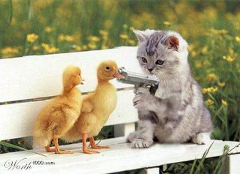
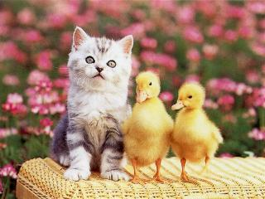
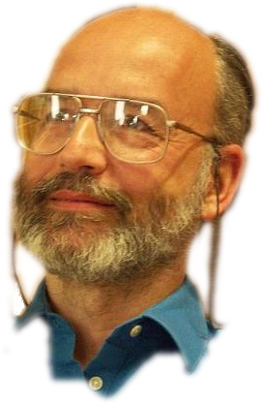
Why Care About Ballot Privacy?
Only to prevent coercion/vote selling
  explicit coercion
  implicit coercion
Is encrypting votes enough?
Encryption may be broken
  Recently: RSA-768
Would you take the risk?
Existing public-key schemes with current key lengths are likely to be broken in less than 30 years!
[RSA conference ’06]

Slide 6
What can we do instead?
Require “everlasting” privacy:
Published receipts give no information about vote
  Even for adversaries with infinite computing power
What does “no information” mean?
  Any set of votes can result in identical bulletin board!
  Impossible to “break” --- all decryptions are equally likely

Slide 7
Problem Solved.
or is it?
If all decryptions are equally likely,
any result is consistent with receipts.
  “proof of consistency” doesn’t mean anything
Replace “proof” with a computational “argument”:
  Computationally bound adversary can only “prove” result consistent with voter intentions

Slide 8
Privacy/Integrity Tradeoff
Integrity
Can make one unconditional
  the other will only hold computationally
Unconditional Integrity
  Even “infinitely powerful” prover cannot fake election results
  Privacy might be broken in the future
Unconditional Privacy
  Prover that can break cryptographic assumption before election day can fake results
  Privacy is “everlasting”
Privacy

Slide 9
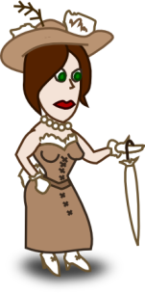


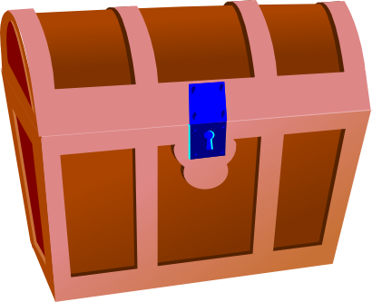
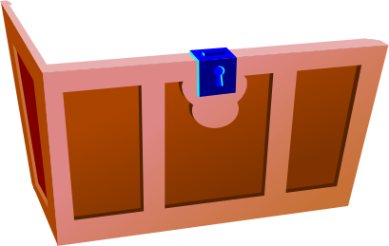


Cryptographic Commitments
Commitment to a value:
  Commit now
    “Hiding”: Alice doesn’t learn contents
  Reveal later
    “Binding”: Bob can’t change the contents
Think of this as Encryption

Slide 10

Computationally-Hiding Commitments
Public-Key Encryption is
  Unconditionally Binding, Computationally Hiding

Slide 11
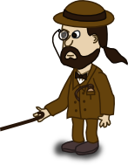
Unconditionally-Hiding Commitments
Alice cannot does not get any information
Binding is only computational
To give protocols “Everlasting Privacy”:
  Replace encryptions with commitments

Slide 12
Example: Pedersen Commitments
Perfectly-Hiding Commitments
G: a cyclic (abelian) group of prime order p
  DLog is hard in G
g,h: generators of G
  No one should know log_{g}h
To commit to m∈Z_{p}:
  Choose random r∈Z_{p}
  Send x=g^{m}h^{r}
Statistically Hiding:
  For any m, x is uniformly distributed in G
Computationally Binding:
  If we can find m’≠m and r’ such that g^{m’}h^{r’}=x then:
  g^{m-m’}=h^{r-r’}≠1, so we can compute log_{g}h=(r-r’)/(m-m’)
x=g^{m}h^{r}
m
r

Slide 13
Example Voting System (MN06)
Based on “Neff-ian” paradigm
  Prove to a human that receipt encodes their vote
  Use Zero-Knowledge simulator for
  receipt-freeness
Uses commitments for everlasting privacy
Let’s move to a slightly simpler setting…

Slide 14






Alice and Bob for Class President
Cory “the Coercer” wants to rig the election
  He can intimidate all the students
Only Mr. Drew is not afraid of Cory
  Everybody trusts Mr. Drew to keep secrets
  Unfortunately, Mr. Drew also wants to rig the election
  Luckily, he doesn't stoop to blackmail
Sadly, all the students suffer severe RSI
  They can't use their hands at all
  Mr. Drew will have to cast their ballots for them

Slide 15




Commitment with “Equivalence Proof”
We use a 20g weight for Alice...
...and a 10g weight for Bob
Using a scale, we can tell if two votes are identical
  Even if the weights are hidden in a box!
The only actions we allow are:
  Open a box
  Compare two boxes

Slide 16
Additional Requirements
An “untappable channel”
  Students can whisper in Mr. Drew's ear
Commitments are secret
  Mr. Drew can put weights in the boxes privately
Everything else is public
  Entire class can see all of Mr. Drew’s actions
  They can hear anything that isn’t whispered
  The whole show is recorded on video (external auditors)
I’m whispering

Slide 17


Ernie Casts a Ballot
Ernie whispers his choice to Mr. Drew
I like Alice

Slide 18

Ernie Casts a Ballot
Mr. Drew puts a box on the scale
Mr. Drew needs to prove to Ernie
that the box contains 20g
  If he opens the box, everyone else will see what Ernie voted for!
Mr. Drew uses a “Zero Knowledge Proof”
Ernie

Slide 19

Ernie Casts a Ballot
Ernie Casts a Ballot
Mr. Drew puts k (=3) “proof” boxes on the table
  Each box should contain a 20g weight
  Once the boxes are on the table, Mr. Drew is committed to their contents
Ernie

Slide 20


Ernie Casts a Ballot
Weigh 1
Open 2
Open 3
Ernie “challenges” Mr. Drew; For each box, Ernie flips a coin and either:
  Asks Mr. Drew to put the box on the scale (“prove equivalence”)
    It should weigh the same as the “Ernie” box
  Asks Mr. Drew to open the box
    It should contain a 20g weight
Ernie
Ernie

Slide 21
Ernie Casts a Ballot
Open 1
Weigh 2
Open 3
If the “Ernie” box doesn’t
contain a 20g weight, every
proof box:
  Either doesn’t contain a 20g weight
  Or doesn’t weight the same as the
  Ernie box
Mr. Drew can fool Ernie with
probability at most 2^{-k}
Ernie

Slide 22


Ernie Casts a Ballot
Why is this Zero Knowledge?
When Ernie whispers to Mr. Drew,
he can tell Mr. Drew what his
challenge will be.
Mr. Drew can put 20g weights in the boxes he will open, and 10g weights in the boxes he weighs
I like Bob
Open 1
Weigh 2
Weigh 3

Slide 23



Ernie Casts a Ballot: Full Protocol
Ernie whispers his choice
and a fake challenge to Mr. Drew
Mr. Drew puts a box on the scale
  it should contain a 20g weight
Mr. Drew puts k “Alice” proof boxes
and k “Bob” proof boxes on the table
  Bob boxes contain 10g or 20g weights according to the fake challenge
I like Alice
Open 1
Weigh 2
Weigh 3
Ernie

Slide 24


Ernie Casts a Ballot: Full Protocol
Ernie shouts the “Alice” (real) challenge and the “Bob” (fake) challenge
Drew responds to the challenges
No matter who Ernie voted for,
The protocol looks exactly the same!
Open 1
Open 2
Weigh 3
Open 1
Weigh 2
Weigh 3
Ernie
Ernie

Slide 25

Implementing a “Scale”
Example for Pedersen Commitments
To prove equivalence of x=g^{m}h^{r} and y=g^{m}h^{s}
  Prover sends t=r-s
  Verifier checks that yh^{t}=x
r
s
g
h
g
h
t=r-s

Slide 26




A “Real” System
Hello Ernie, Welcome to VoteMaster
Please choose your candidate:
Alice
Bob
1 Receipt for Ernie
2 o63ZJVxC91rN0uRv/DtgXxhl+UY=
3 - Challenges -
4 Alice:
5 Sn0w 619- ziggy p3
6 Bob:
7 l4st phone et spla
8 - Response -
9 9NKWoDpGQMWvUrJ5SKH8Q2CtwAQ=
0 === Certified ===

Slide 27
A “Real” System
Hello Ernie, You are voting for Alice
Please enter a fake challenge for Bob
Alice:
Bob :
l4st phone et spla
Continue
1 Receipt for Ernie
2 o63ZJVxC91rN0uRv/DtgXxhl+UY=
3 - Challenges -
4 Alice:
5 Sn0w 619- ziggy p3
6 Bob:
7 l4st phone et spla
8 - Response -
9 9NKWoDpGQMWvUrJ5SKH8Q2CtwAQ=
0 === Certified ===

Slide 28
A “Real” System
Hello Ernie, You are voting for Alice
Make sure the printer has output two
lines (the second line will be covered)
Now enter the real challenge for Alice
Alice:
Sn0w 619- ziggy p3
Bob :
l4st phone et spla
Continue
1 Receipt for Ernie
2 o63ZJVxC91rN0uRv/DtgXxhl+UY=
3 - Challenges -
4 Alice:
5 Sn0w 619- ziggy p3
6 Bob:
7 l4st phone et spla
8 - Response -
9 9NKWoDpGQMWvUrJ5SKH8Q2CtwAQ=
0 === Certified ===

Slide 29
A “Real” System
Hello Ernie, You are voting for Alice
Please verify that the printed challenges
match those you entered.
Alice:
Sn0w 619- ziggy p3
Bob :
l4st phone et spla
Finalize Vote
1 Receipt for Ernie
2 o63ZJVxC91rN0uRv/DtgXxhl+UY=
3 - Challenges -
4 Alice:
5 Sn0w 619- ziggy p3
6 Bob:
7 l4st phone et spla
8 - Response -
9 9NKWoDpGQMWvUrJ5SKH8Q2CtwAQ=
0 === Certified ===

Slide 30
A “Real” System
Hello Ernie, Thank you for voting
Please take your receipt
1 Receipt for Ernie
2 o63ZJVxC91rN0uRv/DtgXxhl+UY=
3 - Challenges -
4 Alice:
5 Sn0w 619- ziggy p3
6 Bob:
7 l4st phone et spla
8 - Response -
9 9NKWoDpGQMWvUrJ5SKH8Q2CtwAQ=
0 === Certified ===
1
2

Slide 31
Counting the Votes
Mr. Drew announces the final tally
Mr. Drew must prove the tally correct
  Without revealing who voted for what!
Recall: Mr. Drew is committed to
everyone’s votes
Alice: 3
Bob: 1
Ernie
Fay
Guy
Heidi

Slide 32

Counting the Votes
Weigh
Weigh
Open
Mr. Drew puts k rows of
new boxes on the table
  Each row should contain the
  same votes in a random order
A “random beacon” gives k challenges
  Everyone trusts that Mr. Drew
  cannot anticipate the
  challenges
Alice: 3
Bob: 1
Ernie
Fay
Guy
Heidi

Slide 33

Counting the Votes
Weigh
Weigh
Open
For each challenge:
  Mr. Drew proves that the row
  contains a permutation of
  the real votes
Alice: 3
Bob: 1
Ernie
Fay
Guy
Heidi
Fay
Guy
Heidi
Ernie

Slide 34
Counting the Votes
Weigh
Weigh
Open
For each challenge:
  Mr. Drew proves that the row
  contains a permutation of
  the real votes
    Or
  Mr. Drew opens the boxes and
  shows they match the tally
Alice: 3
Bob: 1
Ernie
Fay
Guy
Heidi
Fay

Slide 35
Counting the Votes
Weigh
Weigh
Open
If Mr. Drew’s tally is bad
  The new boxes don’t match
  the tally
    Or
  They are not a permutation
  of the committed votes
Drew succeeds with prob.
at most 2^{-k}
Alice: 3
Bob: 1
Ernie
Fay
Guy
Heidi
Fay

Slide 36
Counting the Votes
Weigh
Weigh
Open
This prototocol does not
reveal information about
specific votes:
  No box is both opened and
  weighed
  The opened boxes are in
  a random order
Alice: 3
Bob: 1
Ernie
Fay
Guy
Heidi
Fay

Slide 37
Distributing Mr. Drew?
Mr. Drew knows everyone’s votes
  Must be trusted to maintain privacy
Standard solution: multiple authorities
  Authorities must collude to breach privacy
Everlasting privacy creates a problem:
  Messages cannot contain any information
  How can distributed authorities compute tally?

Slide 38
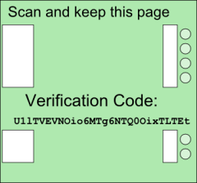
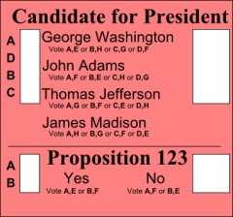
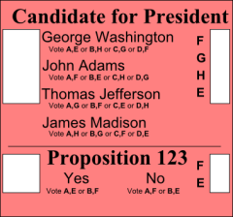
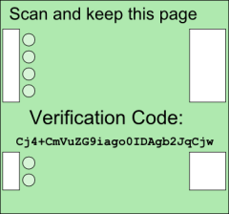
Distributing Mr. Drew?
Idea: Hybrid Systems
  Authorities’ communications are
  computationally hiding
  Published information is unconditionally hiding
What about receipts?
  Voters must trust a computer to secret-share votes
  or do it themselves
  Still some work left to do…

Slide 39

Questions?

